Slide 1
计算机网络 第二章 应用层协议及网络编程
徐敬东 张建忠
xujd@nankai.edu.cn
zhangjz@nankai.edu.cn
计算机网络与信息安全研究室
计算机学院&网络空间安全学院

Slide 2
提 纲
2.1 应用协议与进程通信模型
2.2 传输层服务对应用的支持
2.3 文件传输服务与协议
2.4 Web服务与协议
2.5 电子邮件服务与协议
2.6 域名服务与协议
2.7 对等通信
2.8 网络编程方法

Slide 3

Recall: TCP/IP model
Application
Application
5
5
Peer-layer communication
Transport
Transport
4
Router
Router
4
Network
Network
Network
Network
3
3
Data Link
Data Link
Data Link
Data Link
2
2
Physical
Physical
Physical
Physical
1
1

Slide 4
Applications and application-layer protocols
2.1 应用协议与进程通信模型
Applications: communicating, distributed processes
running in network hosts in “user space”
exchange messages to implement applications
e.g., email, ftp, web
Application-layer protocols
define messages exchanged by apps and actions taken
use communication services provided by lower layer protocols (TCP, UDP)
application
transport
network
data link
physical
application
transport
network
data link
physical
application
transport
network
data link
physical

Slide 5
Processes communicating
2.1 应用协议与进程通信模型
Process: program running within a host.
within same host, two processes communicate using inter-process communication (defined by OS).
processes in different hosts communicate by exchanging messages
client/server model
client host requests, receives service from always-on server
e.g. Web browser/server; email client/server
peer-peer model
minimal (or no) use of dedicated servers
e.g. Skype, BitTorrent

Slide 6
Sockets
2.1 应用协议与进程通信模型
process sends/receives messages to/from its socket
socket analogous to door
sending process shoves message out door
sending process relies on transport infrastructure on other side of door which brings message to socket at receiving process
host
host
controlled by
app developer
process
process
socket
socket
TCP with
buffers,
variables
TCP with
buffers,
variables
Internet
controlled
by OS
API: (1) choice of transport protocol; (2) ability to fix a few parameters

Slide 7

Client-server model
2.1 应用协议与进程通信模型
server process:
waits to be contacted
always-on host
permanent IP address
server farms for scaling
clients process:
initiates communication with server
may be intermittently connected
may have dynamic IP addresses
do not communicate directly with each other
client/server

Slide 8
Pure P2P model
2.1 应用协议与进程通信模型
no always-on server
arbitrary end systems directly communicate
peers are intermittently connected and change IP addresses
Highly scalable but difficult to manage
peer-peer

Slide 9
Hybrid of client-server and P2P
2.1 应用协议与进程通信模型
Skype
voice-over-IP P2P application
centralized server: finding address of remote party
client-client connection: direct (not through server)
Instant messaging
chatting between two users is P2P
centralized service: client presence detection/location
user registers its IP address with central server when it comes online
user contacts central server to find IP addresses of buddies

Slide 10
Addressing processes
2.1 应用协议与进程通信模型
to receive messages, process must have identifier
host device has unique 32-bit IP address
Q: does IP address of host on which process runs suffice for identifying the process?
A: No, many processes can be running on same host

Slide 11
Addressing processes (cont.)
2.1 应用协议与进程通信模型
identifier includes both IP address and port numbers associated with process on host.
Example port numbers:
HTTP server: 80
Mail server: 25
to send HTTP message to www.nankai.edu.cn web server:
IP address: 202.113.16.33
Port number: 80

Slide 12
App-layer protocol defines
2.1 应用协议与进程通信模型
Types of messages exchanged,
e.g., request, response
Message syntax:
what fields in messages & how fields are delineated
Message semantics
meaning of information in fields
Rules for when and how processes send & respond to messages
Public-domain protocols:
defined in RFCs
allows for interoperability
e.g., HTTP, SMTP
Proprietary protocols:
e.g., Skype, QQ

Slide 13
What transport service does an app need?
2.2 传输层服务对应用层的支持
Data loss
some apps (e.g., audio) can tolerate some loss
other apps (e.g., file transfer, telnet) require 100% reliable data transfer
Bandwidth
some apps (e.g., multimedia) require minimum amount of bandwidth to be “effective”
other apps (“elastic apps”) make use of whatever bandwidth they get
Timing
some apps (e.g., Internet telephony, interactive games) require low delay to be “effective”

Slide 14
Tran. service requirements of common apps
2.2 传输层服务对应用层的支持
Application
file transfer
e-mail
Web documents
real-time audio/video
stored audio/video
interactive games
instant messaging
Data loss
no loss
no loss
loss-tolerant
loss-tolerant
loss-tolerant
loss-tolerant
no loss
Throughput
elastic
elastic
elastic
audio: 5kbps-1Mbps
video:10kbps-5Mbps
same as above
few kbps up
elastic
Time Sensitive
no
no
no
yes, 100’s msec
yes, few secs
yes, 100’s msec
yes and no

Slide 15
Internet transport services
2.2 传输层服务对应用层的支持
TCP service:
connection-oriented: setup required between client, server
reliable transport between sending and receiving process
flow control: sender won’t overwhelm receiver
congestion control: throttle sender when network overloaded
does not providing: timing, minimum bandwidth guarantees
UDP service:
unreliable data transfer between sending and receiving process
does not providing: connection setup, reliability, flow control, congestion control, timing, or bandwidth guarantee
Q: Why is there a UDP?

Slide 16
Internet apps: application, transport protocols
2.2 传输层服务对应用层的支持
Application
layer protocol
SMTP [RFC 2821]
HTTP [RFC 2616]
FTP [RFC 959]
HTTP (e.g. Youtube), RTP [RFC 1889]
SIP, RTP, proprietary
(e.g., Skype)
Underlying
transport protocol
TCP
TCP
TCP
TCP or UDP
typically UDP
Application
E-mail
Web Service
file transfer
stream multimedia
Internet telephony

Slide 17
2.3 文件传输服务与协议
Whole-file transfer
User first obtains a local copy of a file and then operates on the copy
Most transfer mechanism operate outside the local file system, i,.e. not integrated
For example
Download: client copy file from server to local
Upload: client copy file from local to server
Application
Off-line remote file access
Software and information distributing

Slide 18

FTP: File Transfer Protocol (RFC 959)
2.3 文件传输服务与协议
FTP
user
interface
file transfer
FTP
client
FTP
server
user
at host
local file
system
remote file
system
major TCP/IP file transfer protocol
transfer file to/from remote host
client/server model
client: initiates transfer (either to/from remote)
server: remote host
Client use TCP to connect to a server

Slide 19
FTP feature
2.3 文件传输服务与协议
Interactive access
User can use command to interact with remote server
Format specification
Allow the client to specify the type and format of stored data
Authentication control
Client must provide a login name and password to server before requesting file transfers
Server refuse access from clients that cannot supply a valid login name and password

Slide 20
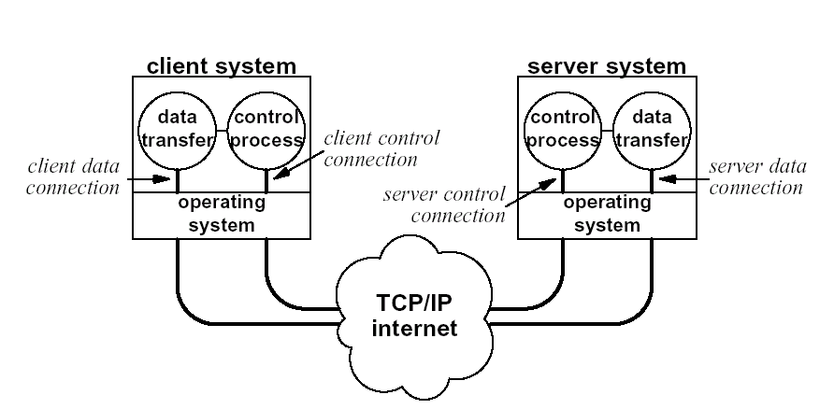
FTP Process Model
2.3 文件传输服务与协议

Slide 21
FTP Process Model (Cont.)
2.3 文件传输服务与协议
Dual connection
Control connection
out of band control
TCP port 21
Maintain FTP a session between client and server
Exchange commands, responses between client and server.
Remain alive throughout a session
Data transfer connection
TCP port 20
Transfer data to/from server
Client can send multiple request to server in a session
Alone data connection is created for each file transfer request
Data connection is released after data transfer is over

Slide 22
FTP Process Model (Cont.)
2.3 文件传输服务与协议
1
2
3
4
5
6
Master server process: daemon at port 21
Client control process: random port
Server control process: port 21
Server data transfer process: port 20
Client data transfer process: random port
Notes:
1. 主服务器进程：守侯在21口
2. 客户控制进程：由用户激活，负责向主服务器进程发出连接请求（参数：服务器地址，本地用于控制连接和用于数据连接的TCP端口等）
3. 服务器控制进程：主服务器进程在接收到客户控制进程而fork出的进程，用于与客户控制进程之间建立控制连接，便进入会话状态
4. 服务器数据传输进程（20口）：当服务器控制进程接收到客户请求（控制命令）后fork出的进程，服务器控制进程向客户控制进程发出连接请求
5. 客户数据传输进程：客户控制进程收到服务器控制进程发来的连接请求后fork出的进程，用于与服务器数据传输进程建立数据传输连接

Slide 23
FTP commands
2.3 文件传输服务与协议
Access Control Commands
USER <SP> <username> <CRLF>
PASS <SP> <password> <CRLF>
ACCT <SP> <account-information> <CRLF>
CWD <SP> <pathname> <CRLF>
CDUP <CRLF>
SMNT <SP> <pathname> <CRLF>
QUIT <CRLF>
REIN <CRLF>
Transfer Parameter Commands
PORT <SP> <host-port> <CRLF>
PASV <CRLF>
TYPE <SP> <type-code> <CRLF>
STRU <SP> <structure-code> <CRLF>
MODE <SP> <mode-code> <CRLF>
Notes:
常用命令
ABOR - abort a file transfer
CWD - change working directory
DELE - delete a remote file
LIST - list remote files
MDTM - return the modification time of a file
MKD - make a remote directory
NLST - name list of remote directory
PASS - send password
PASV - enter passive mode
PORT - open a data port
PWD - print working directory
QUIT - terminate the connection
RETR - retrieve a remote file
RMD - remove a remote directory
RNFR - rename from
RNTO - rename to
SITE - site-specific commands
SIZE - return the size of a file
STOR - store a file on the remote host
TYPE - set transfer type
USER - send username

Slide 24
FTP commands (cont.)
2.3 文件传输服务与协议
FTP Service Commands
RETR <SP> <pathname> <CRLF>
STOR <SP> <pathname> <CRLF>
STOU <CRLF>
APPE <SP> <pathname> <CRLF>
ALLO <SP> <decimal-integer> [<SP> R <SP> <decimal-integer>] <CRLF>
REST <SP> <marker> <CRLF>
RNFR <SP> <pathname> <CRLF>
RNTO <SP> <pathname> <CRLF>
ABOR <CRLF>
DELE <SP> <pathname> <CRLF>
RMD <SP> <pathname> <CRLF>

Slide 25
FTP commands (cont.)
2.3 文件传输服务与协议
FTP Service Commands (cont.)
MKD <SP> <pathname> <CRLF>
PWD <CRLF>
LIST [<SP> <pathname>] <CRLF>
NLST [<SP> <pathname>] <CRLF>
SITE <SP> <string> <CRLF>
SYST <CRLF>
STAT [<SP> <pathname>] <CRLF>
HELP [<SP> <string>] <CRLF>
NOOP <CRLF>

Slide 26
FTP commands and responses
2.3 文件传输服务与协议
Sample commands:
sent as ASCII text over control channel
USER username
PASS password
LIST return list of file in current directory
RETR filename: retrieves (gets) file
STOR filename: stores (puts) file onto remote host
Sample return codes
status code and phrase
331 Username OK, password required
125 data connection already open; transfer starting
425 Can’t open data connection
452 Error writing file

Slide 27
FTP commands and responses
2.3 文件传输服务与协议
PORT: specify a non-default user side data port
PORT h1,h2,h3,h4, p1,p2
200 Command okay
PASV: requests the server-DTP to "listen" on a data port (which is not its default data port) and to wait for a connection
PASV
227 Entering Passive Mode (h1,h2,h3,h4, p1,p2)

Slide 28
FTP commands and responses
2.3 文件传输服务与协议
REST:
the argument field represents the server marker at which file transfer is to be restarted,
does not cause file transfer but skips over the file to the specified data checkpoint. This command shall be immediately followed by the appropriate FTP service command which shall cause file transfer to resume
In nonstructured files, marker is simply a decimal number (position)
REST <marker>
350 Requested file action pending further information
Notes:
SIZE remote-filename
the "SIZE" command is not standardized

Slide 29
FTP User Command
2.3 文件传输服务与协议
FTP only define the interactive method between client and server, and does not specify the user’s interface
FTP user’s interface is difference in various OS, but majority OS provide FTP command similar to BSD UNIX
FTP interactive system
Invoke FTP client
ftp <enter>
Issue commands
ftp> help

Slide 30
FTP User Command (Cont.)
2.3 文件传输服务与协议
! cr macdef proxy send
$ delete mdelete sendport status
account debug mdir put struct
append dir mget pwd sunique
ascii disconnect mkdir quit tenex
bell form mls quote trace
binary get mode recv type
bye glob mput remotehelp user
case hash nmap rename verbose
cd help ntrans reset ?
cdup lcd open rmdir close
ls prompt runique

Slide 31
Connection and Authorization
2.3 文件传输服务与协议
Create control connection
User invoke FTP client program
Execute open command
ftp>open [host name|IP address]
Authorization
FTP server enforce user to input a login name and password
User execute file transfer until login name and password is verified

Slide 32
Connection and Authorization (Cont.)
2.3 文件传输服务与协议
User’s access right to file
FTP server restricts user’s access right to file according to the account, e.g., read, write
Break control connection
Execute close command
ftp>close
close command can not end FTP client program, user can use open command to create new control connection
Close client process
Execute bye or quit command

Slide 33
FTP Anonymous Access
2.3 文件传输服务与协议
Access authorization make FTP service more secure
Each user has a valid account in all FTP server to be accessed is not viable, especially in Internet
Anonymous account
login name: anonymous
password: guest
Anonymous account usually has minimum access right to FTP server, only download some public file
FTP anonymous service is a primary method to information distribution in Internet

Slide 34
Bidirectional File Transfer
2.3 文件传输服务与协议
Download
get: download a single file
mget: download multiple files
Upload
put and send: upload a single file
mput: upload multiple files
Wildcard
FTP allow to use wildcard, usually use (∗)
Wildcard is used to describe a batch of files
file name transform
Solve the uncompatibility between heterogeneous system
FTP client allow user to define the transform regular of file name
hierarchical directory
FTP support hierarchical directory, but all operations are carried to current directory
Relative command: pwd, ls, cd, cdup

Slide 35
File Type and Transfer
2.3 文件传输服务与协议
FTP specifies two types of files to solve heterogeneous problem
text files
binary files
text mode apply to the text-based file, usually use ASCII or EBCDIC code
user can use ascii and ebcdic command to specify which code will be used
binary mode apply to the textless files, e.g., image file, executable file
don’t explain and transform the binary file, copy it directly
Binary mode can not solve the heterogeneous problem, e.g. binary floating point numbers
use default text mode, use binary command to specify binary mode transfer

Slide 36
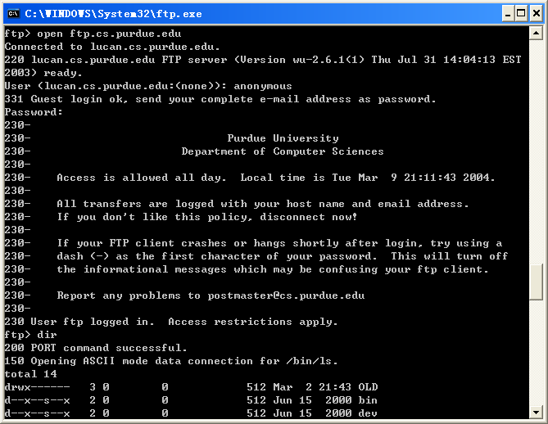
An Example of FTP Session
Notes:
注：客户和服务器之间的控制报文用三位数字开始，后跟文本，软件解释数字

Slide 37
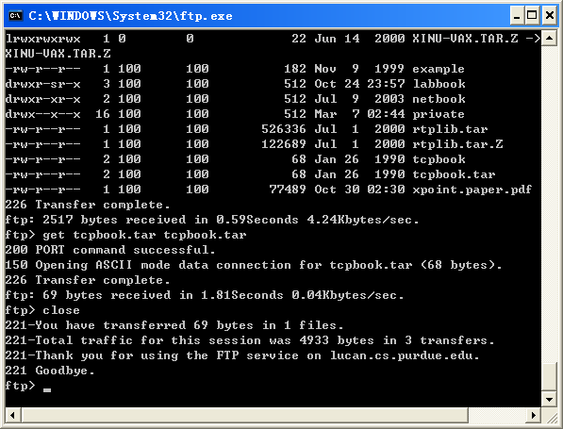
An Example of FTP Session (Cont.)
quit
Notes:
ftp://202.113.29.4

Slide 38
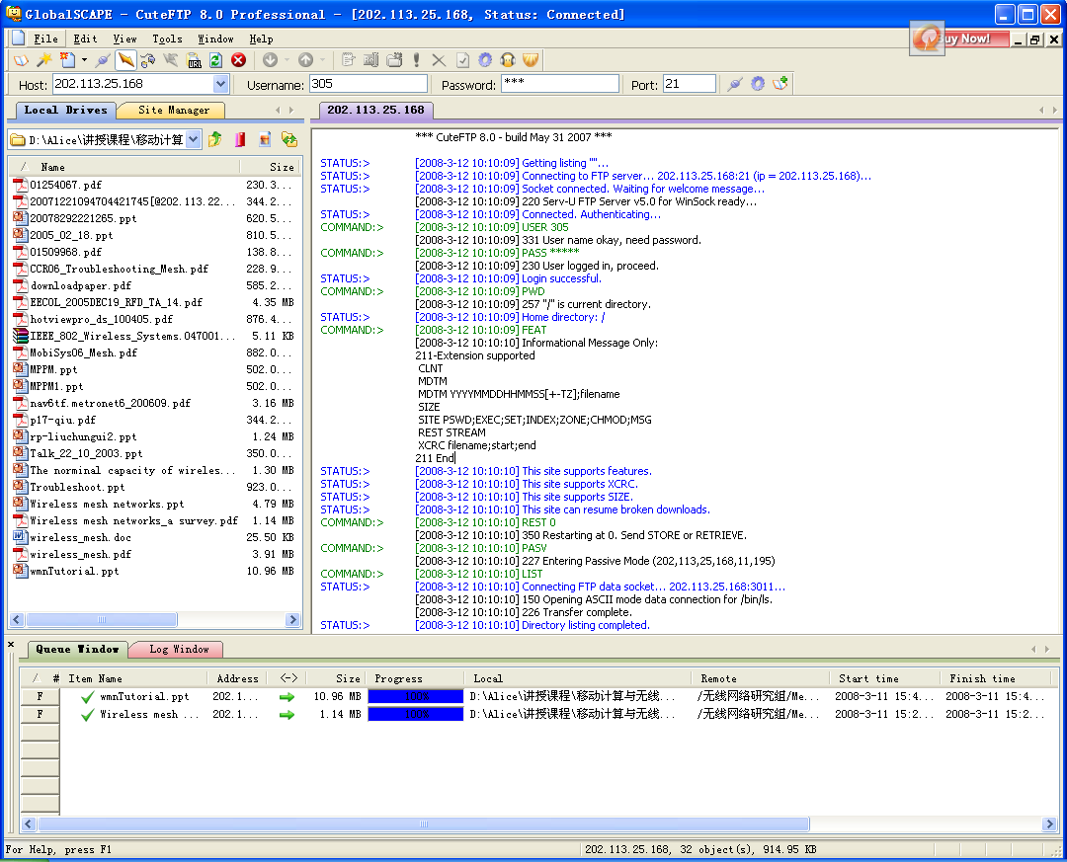
An Example of FTP Session (Cont.)
Notes:
ftp://202.113.29.4

Slide 39
Web Client/server Mode
2.4 Web服务与协议
client: browser that requests, receives, “displays” Web objects
server: Web server sends objects in response to requests
http request
PC running
Explorer
http response
http request
Web server
http response
Mac running
Navigator

Slide 40
Web Client/server Mode
2.4 Web服务与协议

Slide 41
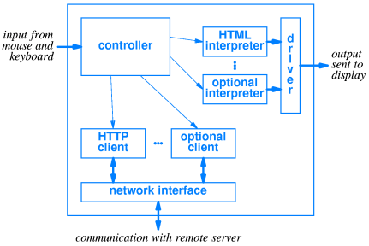
Browser Architecture
2.4 Web服务与协议

Slide 42
HTTP: HyperText Transfer Protocol
2.4 Web服务与协议
standard Web transfer protocol between Web server and client
HTTP usually use TCP connection, but it is not formally required by the standard
HTTP is transaction-oriented client/server protocol, each transaction is treated independently
there is no difference between linking to the same server and linking other server
inefficient but simple

Slide 43
HTTP (Cont.)
2.4 Web服务与协议
HTTP is “stateless”
server maintains no information about past client requests
Protocols that maintain “state” are complex!
past history (state) must be maintained
if server/client crashes, their views of “state” may be inconsistent, must be reconciled
http1.0: RFC 1945
http1.1: RFC 2068

Slide 44
HTTP 1.0 example
2.4 Web服务与协议
(contains text,
references to 10
jpeg images)
Suppose user enters URL www.someSchool.edu/someDepartment/home.index
1a. http client initiates TCP connection to http server (process) at www.someSchool.edu. Port 80 is default for http server.
1b. http server at host www.someSchool.edu waiting for TCP connection at port 80. “accepts” connection, notifying client
2. http client sends http request message (containing URL) into TCP connection socket
3. http server receives request message, forms response message containing requested object (someDepartment/home.index), sends message into socket
time

Slide 45
HTTP 1.0 example (cont.)
2.4 Web服务与协议
4. http server closes TCP connection.
5. http client receives response message containing html file, displays html. Parsing html file, finds 10 referenced jpeg objects
time
6. Steps 1-5 repeated for each of 10 jpeg objects

Slide 46
Non-persistent, persistent connections
2.4 Web服务与协议
Non-persistent
http/1.0: server parses request, responds, closes TCP connection
fetch object need 2 phase
TCP connection
object request/transfer
each transfer suffers from TCP’s initially slow sending rate
Persistent
default for http/1.1
on same TCP connection: server, parses request, responds, parses new request,..
requests and responses can be pipelined on a connection. client sends requests for all referenced objects as soon as it receives base HTML.
fewer RTTs, less slow start.
Notes:
Persistent HTTP connections have a number of advantages:
o By opening and closing fewer TCP connections, CPU time is saved,
and memory used for TCP protocol control blocks is also saved.
o HTTP requests and responses can be pipelined on a connection.
Pipelining allows a client to make multiple requests without
waiting for each response, allowing a single TCP connection to be
used much more efficiently, with much lower elapsed time.
o Network congestion is reduced by reducing the number of packets
caused by TCP opens, and by allowing TCP sufficient time to
determine the congestion state of the network.
o HTTP can evolve more gracefully; since errors can be reported
without the penalty of closing the TCP connection. Clients using
future versions of HTTP might optimistically try a new feature, but
if communicating with an older server, retry with old semantics
after an error is reported.
HTTP implementations SHOULD implement persistent connections.

Slide 47
HTTP message type
2.4 Web服务与协议
request from client to server
response from server to client
request use ASCII
response use MIME

Slide 48
HTTP message format (http 1.1)
2.4 Web服务与协议
HTTP-Message=Simple-Request|Simple-Response|
Full-Request|Full-Response
Full-Request=Request-Line
*(General-Header|Request-Header|Entity-Header)
CRLF
[Entity-Body]
Full-Response=Response-Line
*(General-Header| Response-Header|Entity-Header)
CRLF
[Entity-Body]
Simple-Request=“GET” Request-URL CRLF
Simple-Response=[Entity-Body]

Slide 49
HTTP message format (Cont.)
Request-line: identifies the message type and the requested resource
Response-line: provides status information about this response
General-Header: contains fields that are applicable to both request and response messages but that do not apply to the entity being transferred
Request-Header: contain information about the request and the client
Response-Header: contain information about the response

Slide 50
HTTP message format (Cont.)
2.4 Web服务与协议
Entity header: contain information about the resource identified by the request and information about the entity body
Entity Body
Entity-body=Transfer-Encoding( Content-Encoding (Content-type (data) ) )

Slide 51
Request-line
2.4 Web服务与协议
Format
Request-Line=Method Request-URL HTTP-Version
identify message type and requested resource
Method
GET: request reading page
HEAD: request reading header of page
PUT: request saving page
DELETE：request deleting page
OPTION、POST、PATCH、COPY、MOVE、DELETE、LINK、UNLINK、TRACE、 WRAPPED、Extension-method

Slide 52
HTTP message format: request
2.4 Web服务与协议
request line
(GET, POST,
HEAD commands)
GET /somedir/page.html HTTP/1.0
User-agent: Mozilla/4.0
Accept: text/html, image/gif,image/jpeg
Accept-language:fr
(extra carriage return, line feed)
header
lines
Carriage return,
line feed
indicates end
of message

Slide 53
Response-Line
2.4 Web服务与协议
Format
Response-Line=HTTP-Version Status-Code Reason-Phrase
Provide status information about response
Status-Code: 3 decimals digital, e.g., 200 is OK
Information
Successful
Redirection
Client Error
Server Error
Reason-Phrase：text describing of Status-Code
Notes:
Information：请求被接受，处理在继续，响应中无Entity Body
Successful：请求成功地被接收、理解和接受，响应中的信息依赖请求类型（eg：OK（200）：请求成功，返回适当信息； Accepted：请求被接受但处理未完成）
Redirection：为完成请求要求进一步操作
Client Error：请求中包含语法错或请求不能完成
Server Error ：服务起失效而不能完成有效的请求
o 1xx: Informational - Not used, but reserved for future use
o 2xx: Success - The action was successfully received,
understood, and accepted.
o 3xx: Redirection - Further action must be taken in order to
complete the request
o 4xx: Client Error - The request contains bad syntax or cannot
be fulfilled
o 5xx: Server Error - The server failed to fulfill an apparently
valid request

Slide 54
HTTP response status codes
2.4 Web服务与协议
A few sample codes:
200 OK
request succeeded, requested object later in this message
301 Moved Permanently
requested object moved, new location specified later in this message (Location:)
400 Bad Request
request message not understood by server
404 Not Found
requested document not found on this server
505 HTTP Version Not Supported

Slide 55
HTTP message format: response
2.4 Web服务与协议
status line
(protocol
status code
status phrase)
HTTP/1.0 200 OK
Date: Thu, 06 Aug 1998 12:00:15 GMT
Server: Apache/1.3.0 (Unix)
Last-Modified: Mon, 22 Jun 1998 …...
Content-Length: 6821
Content-Type: text/html
data data data data data ...
header
lines
data, e.g.,
requested
html file

Slide 56
Trying out http (client side) for yourself
2.4 Web服务与协议
http://web.nankai.edu.cn/nkupic/index.htm
telnet web.nankai.edu.cn 80
GET /nkupic/index.htm HTTP/1.0

Slide 57
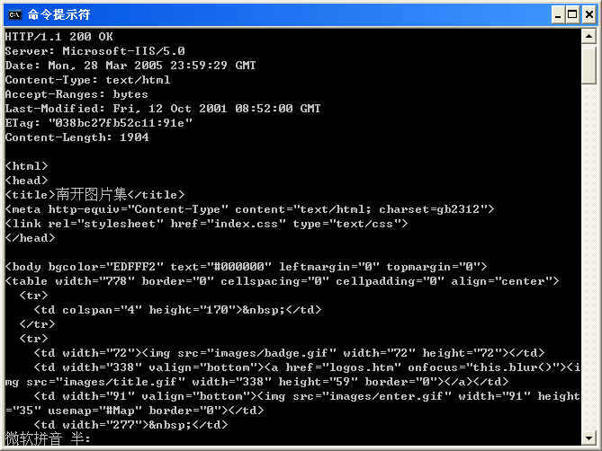
Trying out http (client side) for yourself
http://web.nankai.edu.cn/nkupic/index.htm

Slide 58
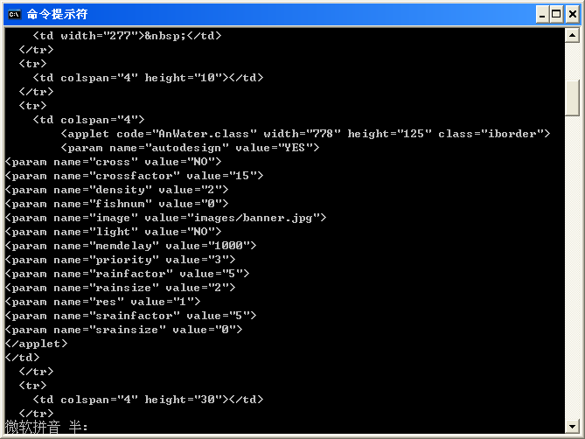
Trying out http (client side) for yourself

Slide 59
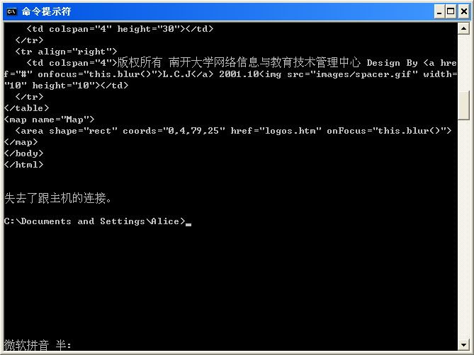
Trying out http (client side) for yourself

Slide 60
Trying out http (client side) for yourself
2.4 Web服务与协议
http://web.nankai.edu.cn/nkupic/index.htm
telnet web.nankai.edu.cn 80
GET /nkupic/index.htm HTTP/1.1
host: web.nankai.edu.cn
GET /nkupic/images/badge.gif HTTP/1.1
host: web.nankai.edu.cn
GET /nkupic/logos.htm HTTP/1.1
host: web.nankai.edu.cn

Slide 61
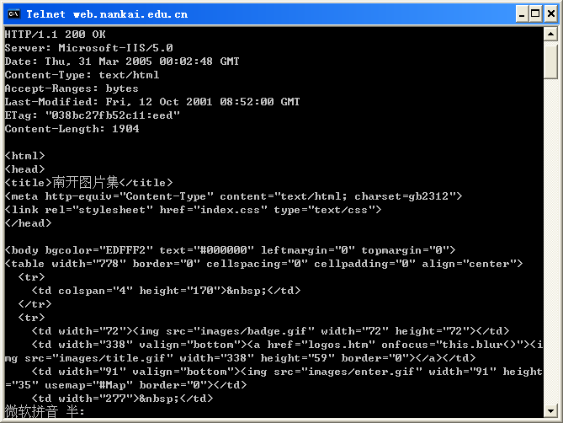
Trying out http (client side) for yourself

Slide 62
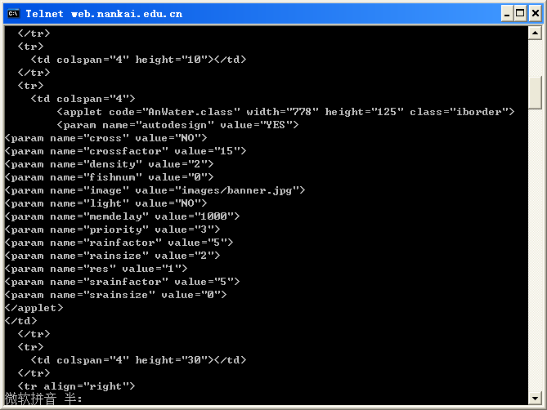
Trying out http (client side) for yourself

Slide 63
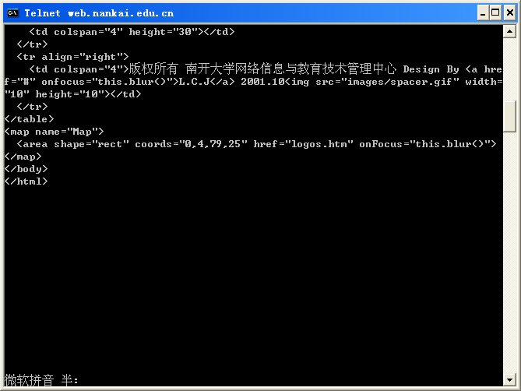
Trying out http (client side) for yourself

Slide 64
Trying out http (client side) for yourself
2.4 Web服务与协议
http://web.nankai.edu.cn/nkupic/index.htm
telnet web.nankai.edu.cn 80
GET /nkupic/index.htm HTTP/1.1
host: web.nankai.edu.cn
connection: close
telnet web.nankai.edu.cn 80
GET /nkupic/index.htm HTTP/1.0
connection: keep-alive
read RFC 2068: 8.1, 8.2, 14.10, 19.7.1,
Notes:
8.1 Persistent Connections
8.1.1 Purpose
Prior to persistent connections, a separate TCP connection was
established to fetch each URL, increasing the load on HTTP servers
and causing congestion on the Internet. The use of inline images and
other associated data often requires a client to make multiple
requests of the same server in a short amount of time. Analyses of
these performance problems are available [30][27]; analysis and
results from a prototype implementation are in [26].
Persistent HTTP connections have a number of advantages:
o By opening and closing fewer TCP connections, CPU time is saved,
and memory used for TCP protocol control blocks is also saved.
o HTTP requests and responses can be pipelined on a connection.
Pipelining allows a client to make multiple requests without
waiting for each response, allowing a single TCP connection to be
used much more efficiently, with much lower elapsed time.
o Network congestion is reduced by reducing the number of packets
caused by TCP opens, and by allowing TCP sufficient time to
determine the congestion state of the network.
o HTTP can evolve more gracefully; since errors can be reported
without the penalty of closing the TCP connection. Clients using
future versions of HTTP might optimistically try a new feature, but
if communicating with an older server, retry with old semantics
after an error is reported.
HTTP implementations SHOULD implement persistent connections.
8.1.2 Overall Operation
A significant difference between HTTP/1.1 and earlier versions of
HTTP is that persistent connections are the default behavior of any
HTTP connection. That is, unless otherwise indicated, the client may
assume that the server will maintain a persistent connection.
Persistent connections provide a mechanism by which a client and a
server can signal the close of a TCP connection. This signaling takes
place using the Connection header field. Once a close has been
signaled, the client MUST not send any more requests on that
connection.
8.1.2.1 Negotiation
An HTTP/1.1 server MAY assume that a HTTP/1.1 client intends to
maintain a persistent connection unless a Connection header including
the connection-token "close" was sent in the request. If the server
chooses to close the connection immediately after sending the
response, it SHOULD send a Connection header including the
connection-token close.
An HTTP/1.1 client MAY expect a connection to remain open, but would
decide to keep it open based on whether the response from a server
contains a Connection header with the connection-token close. In case
the client does not want to maintain a connection for more than that
request, it SHOULD send a Connection header including the
connection-token close.
If either the client or the server sends the close token in the
Connection header, that request becomes the last one for the
connection.
Clients and servers SHOULD NOT assume that a persistent connection is
maintained for HTTP versions less than 1.1 unless it is explicitly
signaled. See section 19.7.1 for more information on backwards
compatibility with HTTP/1.0 clients.
In order to remain persistent, all messages on the connection must
have a self-defined message length (i.e., one not defined by closure
of the connection), as described in section 4.4.
8.1.2.2 Pipelining
A client that supports persistent connections MAY "pipeline" its
requests (i.e., send multiple requests without waiting for each
response). A server MUST send its responses to those requests in the
same order that the requests were received.
Clients which assume persistent connections and pipeline immediately
after connection establishment SHOULD be prepared to retry their
connection if the first pipelined attempt fails. If a client does
such a retry, it MUST NOT pipeline before it knows the connection is
persistent. Clients MUST also be prepared to resend their requests if
the server closes the connection before sending all of the
corresponding responses.
8.1.3 Proxy Servers
It is especially important that proxies correctly implement the
properties of the Connection header field as specified in 14.2.1.
The proxy server MUST signal persistent connections separately with
its clients and the origin servers (or other proxy servers) that it
connects to. Each persistent connection applies to only one transport
link.
A proxy server MUST NOT establish a persistent connection with an
HTTP/1.0 client.
8.1.4 Practical Considerations
Servers will usually have some time-out value beyond which they will
no longer maintain an inactive connection. Proxy servers might make
this a higher value since it is likely that the client will be making
more connections through the same server. The use of persistent
connections places no requirements on the length of this time-out for
either the client or the server.
When a client or server wishes to time-out it SHOULD issue a graceful
close on the transport connection. Clients and servers SHOULD both
constantly watch for the other side of the transport close, and
respond to it as appropriate. If a client or server does not detect
the other side's close promptly it could cause unnecessary resource
drain on the network.
A client, server, or proxy MAY close the transport connection at any
time. For example, a client MAY have started to send a new request at
the same time that the server has decided to close the "idle"
connection. From the server's point of view, the connection is being
closed while it was idle, but from the client's point of view, a
request is in progress.
This means that clients, servers, and proxies MUST be able to recover
from asynchronous close events. Client software SHOULD reopen the
transport connection and retransmit the aborted request without user
interaction so long as the request method is idempotent (see section
9.1.2); other methods MUST NOT be automatically retried, although
user agents MAY offer a human operator the choice of retrying the
request.
However, this automatic retry SHOULD NOT be repeated if the second
request fails.
Servers SHOULD always respond to at least one request per connection,
if at all possible. Servers SHOULD NOT close a connection in the
middle of transmitting a response, unless a network or client failure
is suspected.
Clients that use persistent connections SHOULD limit the number of
simultaneous connections that they maintain to a given server. A
single-user client SHOULD maintain AT MOST 2 connections with any
server or proxy. A proxy SHOULD use up to 2*N connections to another
server or proxy, where N is the number of simultaneously active
users. These guidelines are intended to improve HTTP response times
and avoid congestion of the Internet or other networks.
8.2 Message Transmission Requirements
General requirements:
o HTTP/1.1 servers SHOULD maintain persistent connections and use
TCP's flow control mechanisms to resolve temporary overloads,
rather than terminating connections with the expectation that
clients will retry. The latter technique can exacerbate network
congestion.
o An HTTP/1.1 (or later) client sending a message-body SHOULD monitor
the network connection for an error status while it is transmitting
the request. If the client sees an error status, it SHOULD
immediately cease transmitting the body. If the body is being sent
using a "chunked" encoding (section 3.6), a zero length chunk and
empty footer MAY be used to prematurely mark the end of the
message. If the body was preceded by a Content-Length header, the
client MUST close the connection.
o An HTTP/1.1 (or later) client MUST be prepared to accept a 100
(Continue) status followed by a regular response.
o An HTTP/1.1 (or later) server that receives a request from a
HTTP/1.0 (or earlier) client MUST NOT transmit the 100 (continue)
response; it SHOULD either wait for the request to be completed
normally (thus avoiding an interrupted request) or close the
connection prematurely.
Upon receiving a method subject to these requirements from an
HTTP/1.1 (or later) client, an HTTP/1.1 (or later) server MUST either
respond with 100 (Continue) status and continue to read from the
input stream, or respond with an error status. If it responds with an
error status, it MAY close the transport (TCP) connection or it MAY
continue to read and discard the rest of the request. It MUST NOT
perform the requested method if it returns an error status.
Clients SHOULD remember the version number of at least the most
recently used server; if an HTTP/1.1 client has seen an HTTP/1.1 or
later response from the server, and it sees the connection close
before receiving any status from the server, the client SHOULD retry
the request without user interaction so long as the request method is
idempotent (see section 9.1.2); other methods MUST NOT be
automatically retried, although user agents MAY offer a human
operator the choice of retrying the request.. If the client does
retry the request, the client
o MUST first send the request header fields, and then
o MUST wait for the server to respond with either a 100 (Continue)
response, in which case the client should continue, or with an
error status.
If an HTTP/1.1 client has not seen an HTTP/1.1 or later response from
the server, it should assume that the server implements HTTP/1.0 or
older and will not use the 100 (Continue) response. If in this case
the client sees the connection close before receiving any status from
the server, the client SHOULD retry the request. If the client does
retry the request to this HTTP/1.0 server, it should use the
following "binary exponential backoff" algorithm to be assured of
obtaining a reliable response:
1. Initiate a new connection to the server
2. Transmit the request-headers
3. Initialize a variable R to the estimated round-trip time to the
server (e.g., based on the time it took to establish the
connection), or to a constant value of 5 seconds if the round-trip
time is not available.
4. Compute T = R * (2**N), where N is the number of previous retries
of this request.
5. Wait either for an error response from the server, or for T seconds
(whichever comes first)
6. If no error response is received, after T seconds transmit the body
of the request.
7. If client sees that the connection is closed prematurely, repeat
from step 1 until the request is accepted, an error response is
received, or the user becomes impatient and terminates the retry
process.
No matter what the server version, if an error status is received,
the client
o MUST NOT continue and
o MUST close the connection if it has not completed sending the
message.
An HTTP/1.1 (or later) client that sees the connection close after
receiving a 100 (Continue) but before receiving any other status
SHOULD retry the request, and need not wait for 100 (Continue)
response (but MAY do so if this simplifies the implementation).
14.10 Connection
The Connection general-header field allows the sender to specify
options that are desired for that particular connection and MUST NOT
be communicated by proxies over further connections.
The Connection header has the following grammar:
Connection-header = "Connection" ":" 1#(connection-token)
connection-token = token
HTTP/1.1 proxies MUST parse the Connection header field before a
message is forwarded and, for each connection-token in this field,
remove any header field(s) from the message with the same name as the
connection-token. Connection options are signaled by the presence of
a connection-token in the Connection header field, not by any
corresponding additional header field(s), since the additional header
field may not be sent if there are no parameters associated with that
connection option. HTTP/1.1 defines the "close" connection option
for the sender to signal that the connection will be closed after
completion of the response. For example,
Connection: close
in either the request or the response header fields indicates that
the connection should not be considered `persistent' (section 8.1)
after the current request/response is complete.
HTTP/1.1 applications that do not support persistent connections MUST
include the "close" connection option in every message.
19.7.1 Compatibility with HTTP/1.0 Persistent Connections
Some clients and servers may wish to be compatible with some previous
implementations of persistent connections in HTTP/1.0 clients and
servers. Persistent connections in HTTP/1.0 must be explicitly
negotiated as they are not the default behavior. HTTP/1.0
experimental implementations of persistent connections are faulty,
and the new facilities in HTTP/1.1 are designed to rectify these
problems. The problem was that some existing 1.0 clients may be
sending Keep-Alive to a proxy server that doesn't understand
Connection, which would then erroneously forward it to the next
inbound server, which would establish the Keep-Alive connection and
result in a hung HTTP/1.0 proxy waiting for the close on the
response. The result is that HTTP/1.0 clients must be prevented from
using Keep-Alive when talking to proxies.
However, talking to proxies is the most important use of persistent
connections, so that prohibition is clearly unacceptable. Therefore,
we need some other mechanism for indicating a persistent connection
is desired, which is safe to use even when talking to an old proxy
that ignores Connection. Persistent connections are the default for
HTTP/1.1 messages; we introduce a new keyword (Connection: close) for
declaring non-persistence.
The following describes the original HTTP/1.0 form of persistent
connections.
When it connects to an origin server, an HTTP client MAY send the
Keep-Alive connection-token in addition to the Persist connection-
token:
Connection: Keep-Alive
An HTTP/1.0 server would then respond with the Keep-Alive connection
token and the client may proceed with an HTTP/1.0 (or Keep-Alive)
persistent connection.
An HTTP/1.1 server may also establish persistent connections with
HTTP/1.0 clients upon receipt of a Keep-Alive connection token.
However, a persistent connection with an HTTP/1.0 client cannot make
use of the chunked transfer-coding, and therefore MUST use a
Content-Length for marking the ending boundary of each message.
A client MUST NOT send the Keep-Alive connection token to a proxy
server as HTTP/1.0 proxy servers do not obey the rules of HTTP/1.1
for parsing the Connection header field.
19.7.1.1 The Keep-Alive Header
When the Keep-Alive connection-token has been transmitted with a
request or a response, a Keep-Alive header field MAY also be
included. The Keep-Alive header field takes the following form:
Keep-Alive-header = "Keep-Alive" ":" 0# keepalive-param
keepalive-param = param-name "=" value
The Keep-Alive header itself is optional, and is used only if a
parameter is being sent. HTTP/1.1 does not define any parameters.
If the Keep-Alive header is sent, the corresponding connection token
MUST be transmitted. The Keep-Alive header MUST be ignored if
received without the connection token.

Slide 65
User-server interaction: authentication
2.4 Web服务与协议
Authentication : control access to server content
authorization credentials: typically name, password
stateless: client must present authorization in each request
authorization: header line in each request
if no authorization in header, server refuses access, sends
WWW authenticate:
in header line in response
client
server
usual http request msg
401: authorization req.
WWW authenticate:
usual http request msg
+ Authorization: <cred>
usual http response msg
usual http request msg
+ Authorization: <cred>
time
usual http response msg

Slide 66
Cookies: keeping “state” (RFC 6265)
2.4 Web服务与协议
server-generated # , server-remembered #, later used for:
authentication
remembering user preferences, previous choices
server sends “cookie” to client in response msg
Set-cookie: 1678453
client presents cookie in later requests
cookie: 1678453
client
server
usual http request msg
usual http response +
Set-cookie: #
usual http request msg
cookie: #
cookie-
spectific
action
usual http response msg
usual http request msg
cookie: #
cookie-
spectific
action
usual http response msg
Notes:
RFC 2109: HTTP State Management Mechanism
The origin server initiates a session。
Note that "session" here does not refer to a persistent network connection but
to a logical session created from HTTP requests and responses. The
presence or absence of a persistent connection should have no effect
on the use of cookie-derived sessions.
一个Cookies是Web服务器存放在用户硬盘的一段文本，Cookies允许一个Web站点在用户的机器存放一些文本的信息，并可以在以后重新获取它。这个基于文本的信息存储着一些“键－值”对。

Slide 67
Cookies: keeping “state” (RFC 6265)
2.4 Web服务与协议
Server→User Agent
Set-Cookie: SID=31d4d96e407aad42; Path=/;
Domain=example.com
User Agent →Server
Cookie: SID=31d4d96e407aad42
Notes:
RFC 2109: HTTP State Management Mechanism
The origin server initiates a session。
Note that "session" here does not refer to a persistent network connection but
to a logical session created from HTTP requests and responses. The
presence or absence of a persistent connection should have no effect
on the use of cookie-derived sessions.
一个Cookies是Web服务器存放在用户硬盘的一段文本，Cookies允许一个Web站点在用户的机器存放一些文本的信息，并可以在以后重新获取它。这个基于文本的信息存储着一些“键－值”对。

Slide 68
Conditional GET: client-side caching
2.4 Web服务与协议
Goal: don’t send object if client has up-to-date cached version
client: specify date of cached copy in http request
If-modified-since: <date>
server: response contains no object if cached copy is up-to-date:
HTTP/1.0 304 Not Modified
client
server
http request msg
If-modified-since: <date>
object
not
modified
http response
HTTP/1.0
304 Not Modified
http request msg
If-modified-since: <date>
object
modified
http response
HTTP/1.1 200 OK
<data>

Slide 69
Web Caches (proxy server)
2.4 Web服务与协议
Goal: satisfy client request without involving origin server
user sets browser: Web accesses via web cache
client sends all http requests to web cache
object in web cache: web cache returns object
else web cache requests object from origin server, then returns object to client
origin
server
Proxy
server
http request
http request
client
http response
http response
http request
http response
client
origin
server

Slide 70
Uniform Resource Locators
2.4 Web服务与协议
format

Slide 71
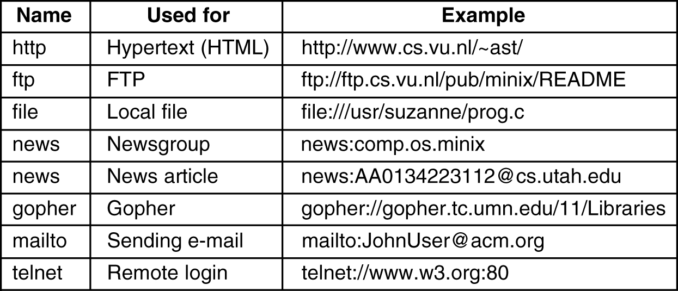
Uniform Resource Locators (cont.)
2.4 Web服务与协议
protocol type

Slide 72
HyperText Markup Language (RFC 1866)
2.4 Web服务与协议
document structure
<HTML>
<HEAD>
<TITLE>
……
</TITLE>
</HEAD>
<BODY>
……
</BODY>
</HTML>

Slide 73
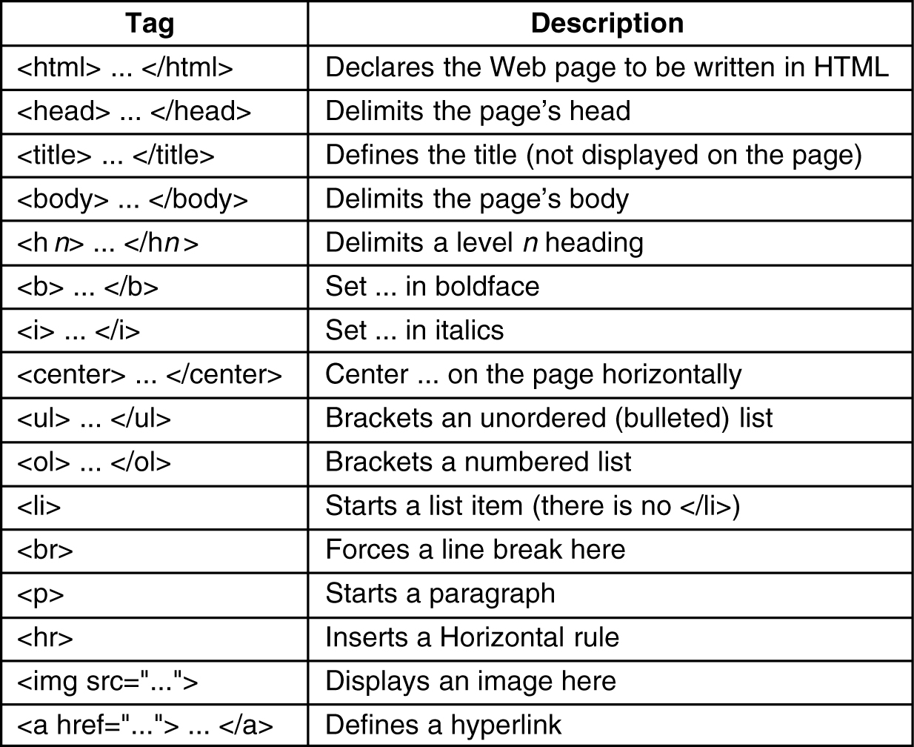
HyperText Markup Language (cont.)
2.4 Web服务与协议

Slide 74

HyperText Markup Language (cont.)
2.4 Web服务与协议
example

Slide 75
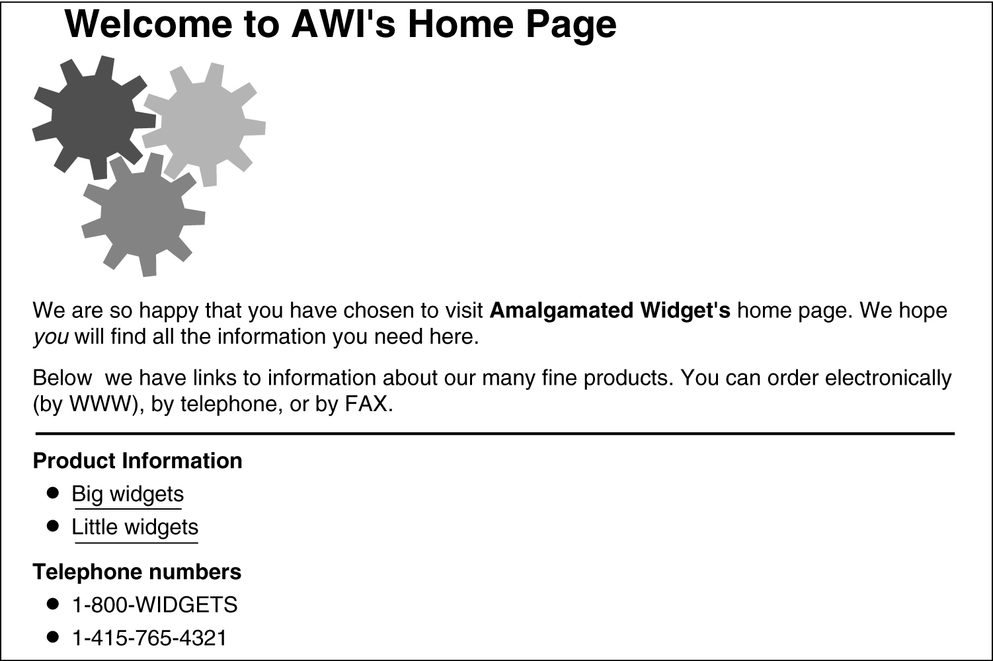
HyperText Markup Language (cont.)
2.4 Web服务与协议
example

Slide 76
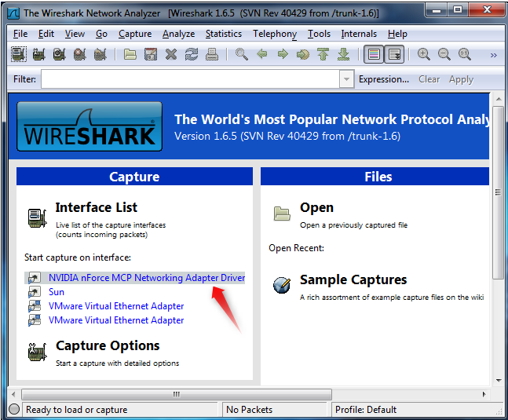

Slide 77
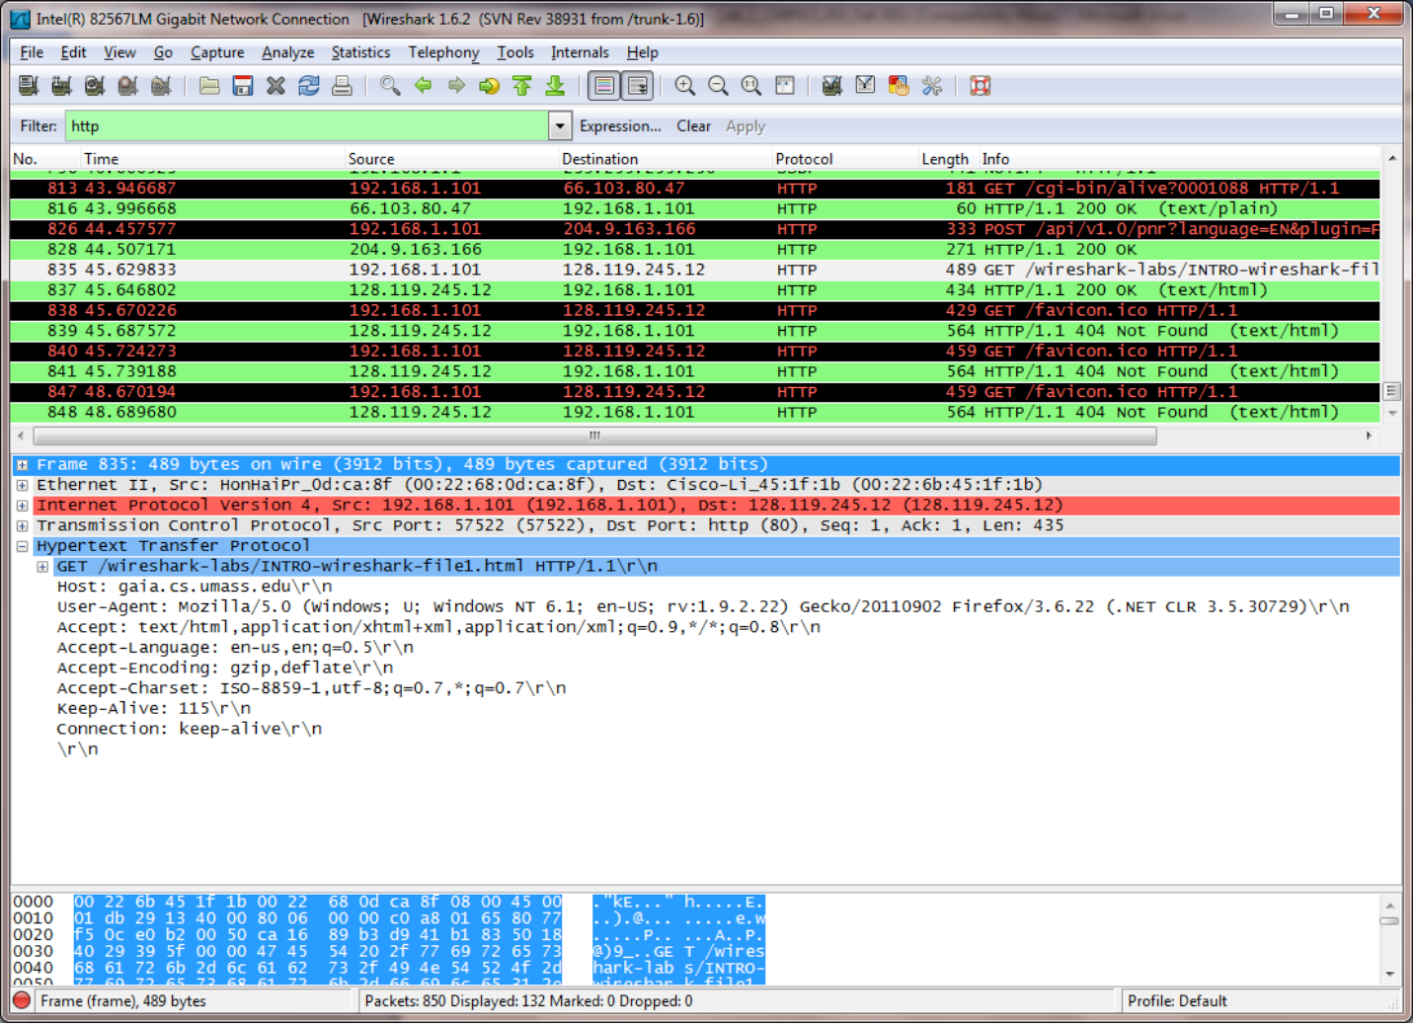

Slide 78
Electronic Mail System
2.5 电子邮件服务与协议
user
agent
Electronic mail system include three major components
user agents (interface)
mail servers
simple mail transfer protocol: smtp
mail
server
user
agent
SMTP
mail
server
user
agent
SMTP
SMTP
mail
server
user
agent
outgoing
message queue
user
agent
user mailbox
user
agent

Slide 79
Electronic Mail System (Cont.)
2.5 电子邮件服务与协议
User Agents (interface)
edit and send mail
receive, read and manage mail
manage address book
no uniform standard
Mail Servers
mailbox contains incoming messages (yet to be read) for user
message queue of outgoing (to be sent) mail messages
smtp protocol between mail servers to send email messages
smtp client: sending mail server
smtp server: receiving mail server
user
agent
mail
server
user
agent
SMTP
mail
server
user
agent
SMTP
SMTP
mail
server
user
agent
user
agent
user
agent

Slide 80
Mail Client/server Mode（SMTP/POP）
2.5 电子邮件服务与协议

Slide 81
Mail Client/server Mode (cont.)
2.5 电子邮件服务与协议
user interface: edit and read mail
mail transfer process (SMTP client): connect and transfer mail to SMTP server
mail server process (SMTP server): receive mail from SMTP client, and forward mail or distribute mail to mailbox
POP client: connect POP server, and send reading mail request
POP server: receive POP client request, and read mail from mailbox

Slide 82
Mail Client/server Mode（HTTP）
2.5 电子邮件服务与协议

Slide 83
Mailbox Names
2.5 电子邮件服务与协议
Users specify recipients by giving pairs of string, i.e., Mail address
local-part@domain-name
domain-name: domain name of a mail destination
local-part: mailbox name in mail server
Example
aaa@hotmail.com
david@eyou.com

Slide 84
SMTP: Simple Mail Transfer Protocol
2.5 电子邮件服务与协议
uses TCP to reliably transfer email message from client to server
direct transfer: sending server to receiving server
three phases of transfer
handshaking (greeting)
transfer of messages
closure
command/response interaction
commands: ASCII text
response: status code and phrase
messages must be in 7-bit ASCII
RFC 821: SMTP

Slide 85
SMTP (Cont.)
2.5 电子邮件服务与协议
SMTP server listens at TCP port 25
SMTP client establish a TCP connection to port 25 of SMTP server, and wait the response of server
if the server is willing to accept mail, the client announces whom the mail is coming from and whom it is going to
if a recipient exists at the destination, the server gives the client the go-ahead to send the message
the client sends the message and the server acknowledges it
when all the mail has been exchanged in both directions, the connection is released

Slide 86
Simple Mail Transfer Protocol (cont.)
2.5 电子邮件服务与协议
S:220 xyz.com SMTP service ready
C:HELO abc.com
S:250 xyz.com says hello to abc.com
C:MAIL FROM:elinor@abc.com
S:250 sender ok
C:RCPT TO:<carolyn@xyz.com>
S:250 recipient ok
C:DATA
S:354 Send mail; end with “.” on a line by itself
C:From:elinor@abc.com
C:To:carolyn@xyz.com
C:MIME-Version:1.0
C:Message-Id:<0704760941.AA00747@abc.com>
C:Content-Type:multipart/alternative;boundary= qwertyuiopasdfghjklzxcvbnm
C:Subject:Earth orbits sun integral number of times
SMTP example

Slide 87
Simple Mail Transfer Protocol (Cont.)
2.5 电子邮件服务与协议
C:This is the preamble.The user agent ignores it. Have a nice day.
C:
C-- qwertyuiopasdfghjklzxcvbnm
C:Content-Type:text/richtext
C:
C:Happy birthday to you
C:Happy birthday to you
C:Happy birthday to you <bold>Carolyn</bold>
C:Happy birthday to you
C:--qwertyuiopasdfghjklzxcvbnm
C:.
S:250 message accepted
C:QUIT
S:221 xyz.xom closing connection
SMTP example (cont.)

Slide 88
SMTP (Cont.)
2.5 电子邮件服务与协议
HELO <SP> <domain> <CRLF>
MAIL <SP> FROM:<reverse-path> <CRLF>
RCPT <SP> TO:<forward-path> <CRLF>
DATA <CRLF>
RSET <CRLF>
SEND <SP> FROM:<reverse-path> <CRLF>
SOML <SP> FROM:<reverse-path> <CRLF>
SAML <SP> FROM:<reverse-path> <CRLF>
VRFY <SP> <string> <CRLF>
EXPN <SP> <string> <CRLF>
HELP [<SP> <string>] <CRLF>
NOOP <CRLF> QUIT <CRLF>
TURN <CRLF>

Slide 89

Mail access protocols
2.5 电子邮件服务与协议
SMTP
HTTP
POP3、HTTP
IMAP
SMTP
user
agent
user
agent
sender’s mail
server
receiver’s mail
server
SMTP: delivery/storage to sender’s mail server
Mail access protocol: fetch or read mail from the mailbox of receiver’s mail server
POP: Post Office Protocol [RFC 1939]
IMAP: Internet Mail Access Protocol [RFC 2060]
HTTP: Hotmail , Yahoo! Mail, etc

Slide 90
POP3 protocol
2.5 电子邮件服务与协议
consist of ASCII text
fetch mail from receiver’s mailbox and store it on the user’s local machine to be read later
command:
log in
transaction (fetch and delete mail)
log out

Slide 91
POP3 protocol
2.5 电子邮件服务与协议
S: +OK POP3 server ready
C: user alice
S: +OK
C: pass hungry
S: +OK user successfully logged on
login phase
client commands:
user: declare username
pass: password
server responses
+OK
-ERR
transaction phase
list: list message numbers
retr: retrieve message by number
dele: delete
logout phase
quit
C: list
S: 1 498
S: 2 912
S: .
C: retr 1
S: <message 1 contents>
S: .
C: dele 1
C: retr 2
S: <message 1 contents>
S: .
C: dele 2
C: quit
S: +OK POP3 server signing off

Slide 92
POP3 (cont.)
S: <wait for connection on TCP port 110>
...
C: <open connection>
S: +OK dewey POP3 server ready (Comments to: PostMaster@UDEL.EDU)
C: USER mrose
S: +OK mrose is a real hoopy frood
C: PASS secret
S: +OK mrose's maildrop has 2 messages (320 octets)
C: STAT
S: +OK 2 320
C: LIST
S: +OK 2 messages (320 octets)
S: 1 120
S: 2 200
S: .
C: RETR 1
pop3 session example

Slide 93
POP3 (cont.)
S: +OK 120 octets
S: <the POP3 server sends message 1>
S: .
C: DELE 1
S: +OK message 1 deleted
C: RETR 2
S: +OK 200 octets
S: <the POP3 server sends message 2>
S: .
C: DELE 2
S: +OK message 2 deleted
C: QUIT
S: +OK POP3 server signing off (maildrop empty)
C: <close connection>
S: <wait for next connection>
pop3 session example (cont.)

Slide 94
POP3 command
2.5 电子邮件服务与协议
Minimal POP3 Commands:
USER name
PASS string
QUIT
STAT
LIST [msg]
RETR msg
DELE msg
NOOP
RSET
QUIT
Optional POP3 Commands:
APOP name digest
TOP msg n
UIDL [msg]
POP3 Replies:
+OK
-ERR

Slide 95
Mail Message Format
2.5 电子邮件服务与协议
envelope
encapsulate the message
contain the information needed for transporting the message
destination address, priority, security level
message
message header
contain control information for user interface (agent)
message body

Slide 96
Mail Message Format (Cont.)
2.5 电子邮件服务与协议
basic ASCII mail (RFC 822)
RFC 822 is an old standard and does not clearly distinguish envelope from message header
RFC 822 can only transfer text message written in English
multipurpose Internet mail extension (MIME, RFC 2045, 2046)
transfer multimedia message and binary file

Slide 97
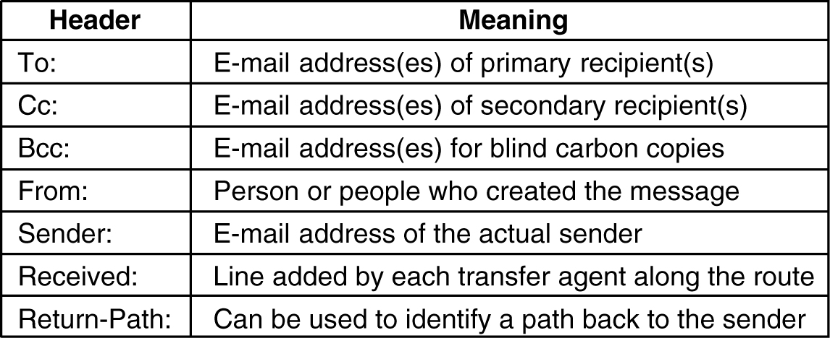
RFC 822
2.5 电子邮件服务与协议
principle header fields related to message transport

Slide 98
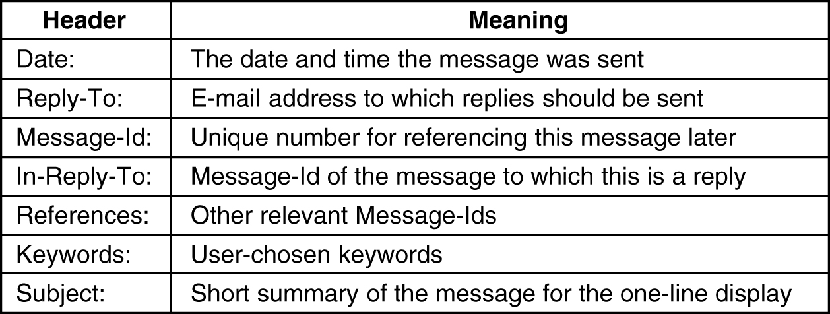
RFC 822 (Cont.)
2.5 电子邮件服务与协议
some fields used in the message header
private header starts with string X-, e.g., X-Charset, X-Mailer, X_Sender, X-Face

Slide 99
MIME
2.5 电子邮件服务与协议
problems with international languages
Languages with accents (e.g., French, German)
Languages in non-Latin alphabets (e.g., Hebrew, Russian)
Languages without alphabets (e.g., Chinese, Japanese)
Messages not containing text at all (e.g., audio or images)
Notes:
RFC-822 Standard for the format of ARPA Internet text messages
RFC-2045 Multipurpose Internet Mail Extensions (MIME) Part One: Format of Internet Message Bodies
RFC-2046 Multipurpose Internet Mail Extensions (MIME) Part Two: Media Types
RFC-2047 Multipurpose Internet Mail Extensions (MIME) Part Three: Message Header Extensions for Non-ASCII Text
RFC-2048 Multipurpose Internet Mail Extensions (MIME) Part Four: Registration Procedures
RFC-2049 Multipurpose Internet Mail Extensions (MIME) Part Five: Conformance Criteria and Examples

Slide 100
MIME (Cont.)
2.5 电子邮件服务与协议
MIME continues to use RFC 822 format, but to add structure to the message body and define encoding rules for non-ASCII message
MIME message can be sent using the existing mail programs and protocols, but need that user interface programs (agent) can explain MIME format

Slide 101
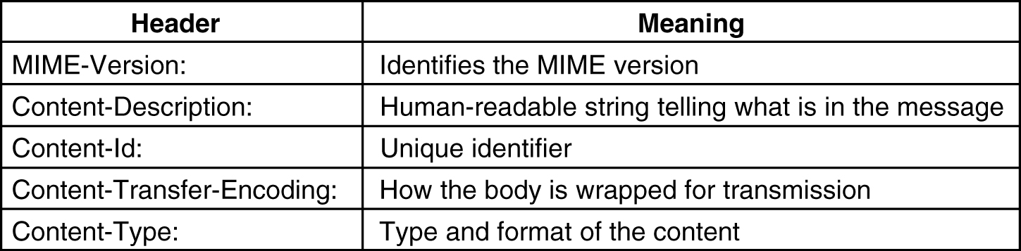
MIME (Cont.)
2.5 电子邮件服务与协议
RFC 822 headers added by MIME

Slide 102
MIME (Cont.)
2.5 电子邮件服务与协议
From: alice@crepes.fr
To: bob@hamburger.edu
Subject: Picture of yummy crepe.
MIME-Version: 1.0
Content-Transfer-Encoding: base64
Content-Type: image/jpeg
base64 encoded data .....
.........................
......base64 encoded data
MIME version
method used
to encode data
multimedia data
type, subtype,
parameter declaration
encoded data

Slide 103
MIME encoding schemes
2.5 电子邮件服务与协议
ASCII text
7 bits
carried directly by the original mail protocol
no line exceed 1000 characters
8-bit text
all values from 0 up to and including 255
used by some parts of the Internet
implement some extensions to the original protocol
no line exceed 1000 characters
no guarantee

Slide 104
MIME encoding schemes (Cont.)
2.5 电子邮件服务与协议
binary encoding
arbitrary binary file
8-bit encoding
implement some extensions to the original protocol
no 1000 character line limit
no guarantee
e.g., executable program

Slide 105
MIME encoding schemes (Cont.)
2.5 电子邮件服务与协议
base64 encoding (ASCII armor)
groups of 24 bits are broken up into four 6-bit units
each unit is sent as a legal ASCII character
26 uppercase, 26 lowercase, ten digits, and finally + and /, e.g., “A” for 0, “B” for 1
== and =sequences are used to indicate that the last group contained only 8 or 16 bits
carriage return and line feed are ignored
arbitrary binary text can be sent safely
Notes:
Special processing is performed if fewer than 24 bits are available
at the end of the data being encoded. A full encoding quantum is
always completed at the end of a body. When fewer than 24 input bits
are available in an input group, zero bits are added (on the right)
to form an integral number of 6-bit groups. Padding at the end of
the data is performed using the "=" character. Since all base64
input is an integral number of octets, only the following cases can
arise: (1) the final quantum of encoding input is an integral
multiple of 24 bits; here, the final unit of encoded output will be
an integral multiple of 4 characters with no "=" padding, (2) the
final quantum of encoding input is exactly 8 bits; here, the final
unit of encoded output will be two characters followed by two "="
padding characters, or (3) the final quantum of encoding input is
exactly 16 bits; here, the final unit of encoded output will be three
characters followed by one "=" padding character.

Slide 106
Base64 encoding (Cont.)
2.5 电子邮件服务与协议
the final quantum of encoding input is an integral multiple of 24 bits; here, the final unit of encoded output will be an integral multiple of 4 characters with no "=" padding
the final quantum of encoding input is exactly 8 bits; here, the final unit of encoded output will be two characters followed by two "=" padding characters
xxxxxx xx0000
the final quantum of encoding input is exactly 16 bits; here, the final unit of encoded output will be three characters followed by one "=" padding character
xxxxxx xxxxxx xxxx00

Slide 107
MIME encoding schemes (Cont.)
2.5 电子邮件服务与协议
quoted-printable encoding
7-bit ASCII
all the characters above 127 encoded as an equal sign(=) followed by the character’s value as two hexadecimal digits
Uppercase letters must be used; lowercase letters are not allowed
for example, the decimal value 230 (binary value 1110 0110) can be represented by "=E6", and the decimal value 61 (=) (binary value 0011 1101) can be represented by "=3D".
adapt to almost entirely ASCII, but with a few non-ASCII characters
Notes:
(General 8bit representation) Any octet, except a CR or
LF that is part of a CRLF line break of the canonical
(standard) form of the data being encoded, may be
represented by an "=" followed by a two digit
hexadecimal representation of the octet's value. The
digits of the hexadecimal alphabet, for this purpose,
are "0123456789ABCDEF". Uppercase letters must be
used; lowercase letters are not allowed. Thus, for
example, the decimal value 12 (US-ASCII form feed) can
be represented by "=0C", and the decimal value 61 (US-
ASCII EQUAL SIGN) can be represented by "=3D". This
rule must be followed except when the following rules
allow an alternative encoding.

Slide 108
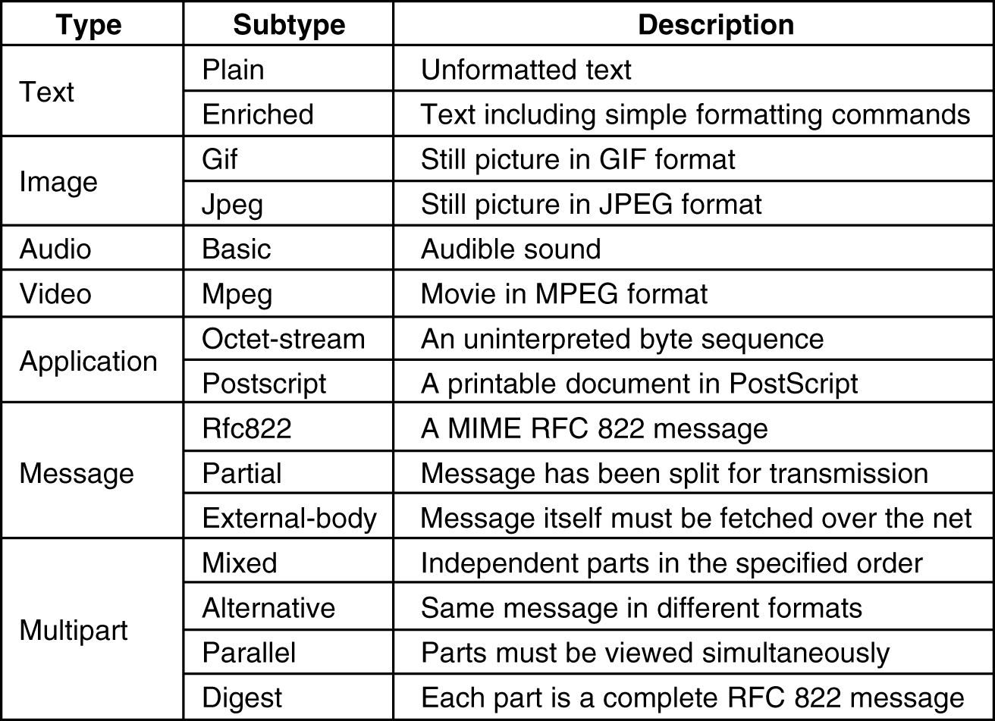
MIME types
2.5 电子邮件服务与协议
Content-Type: type/subtype; parameters
subtype must be given explicitly, no default are provided
audio and video: if a movie with sound is to be transmitted, the video and audio portions may have to be transmitted separately, depending on the encoding system used
application: is a catchall for formats that require external processing not covered by one of the other types
message: allows one message to be fully encapsulated inside another, usually be used to forward email
partial: break an encapsulated message up into pieces and send them separately, reassemble all parts at the destination

Slide 109
MIME types
2.5 电子邮件服务与协议
Content-Type: type/subtype; parameters
subtype must be given explicitly, no default are provided
audio and video: if a movie with sound is to be transmitted, the video and audio portions may have to be transmitted separately, depending on the encoding system used
application: is a catchall for formats that require external processing not covered by one of the other types
message: allows one message to be fully encapsulated inside another, usually be used to forward email
partial: break an encapsulated message up into pieces and send them separately, reassemble all parts at the destination

Slide 110
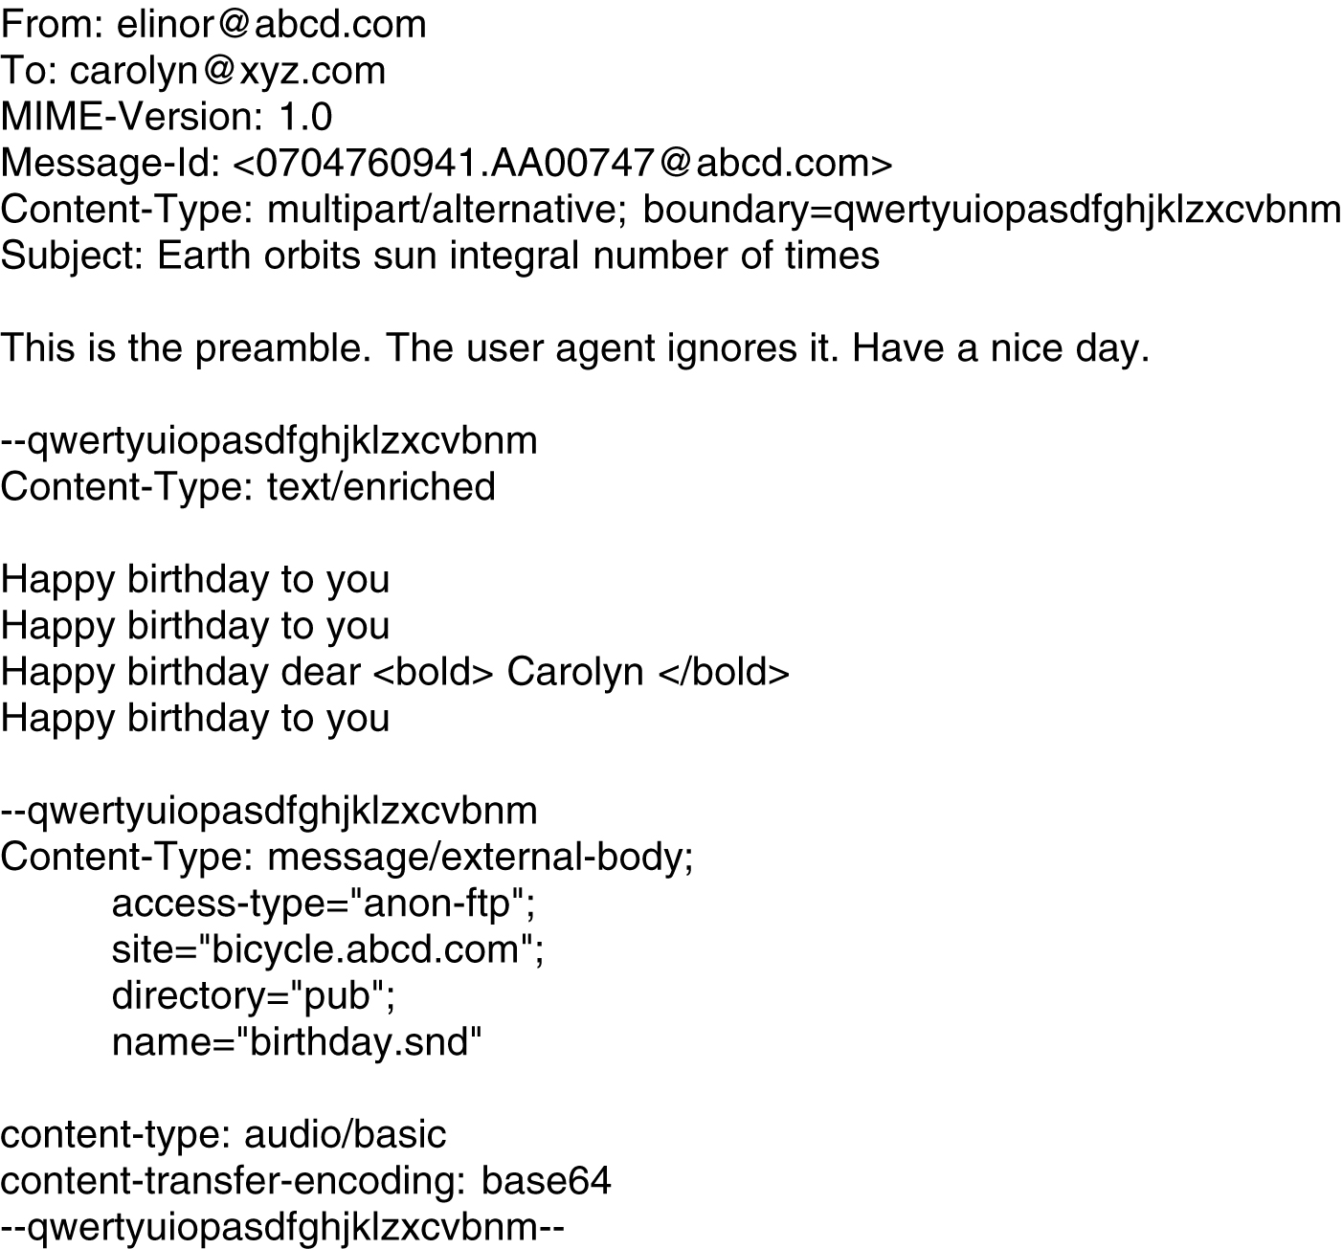
Example of MIME
A multipart message containing enriched and audio alternatives

Slide 111
telnet SMTP server
2.5 电子邮件服务与协议
Example:
telnet nankai.edu.cn 25

Slide 112
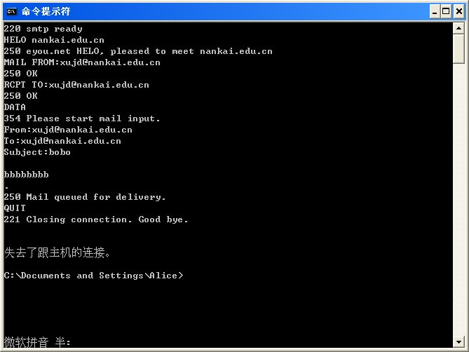
telnet SMTP server
Example:
telnet nankai.edu.cn 25

Slide 113
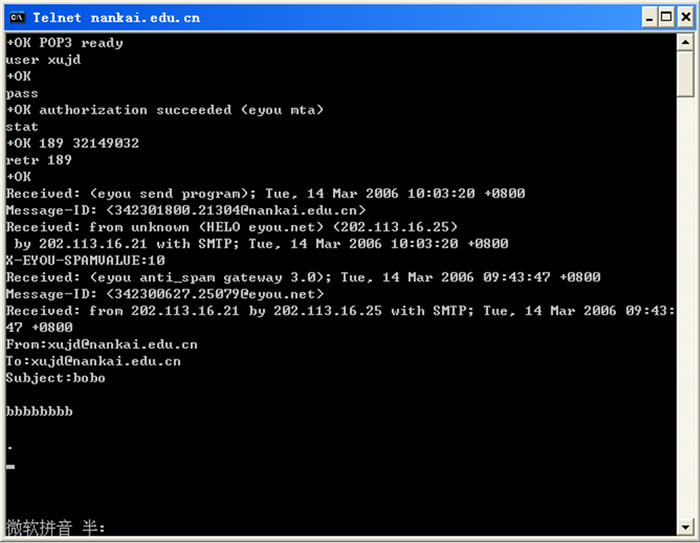
telnet POP3 server
Example:
telnet nankai.edu.cn 110
Notes:
received = "Received" ":" ; one per relay
["from" domain] ; sending host
["by" domain] ; receiving host
["via" atom] ; physical path
*("with" atom) ; link/mail protocol
["id" msg-id] ; receiver msg id
["for" addr-spec] ; initial form
";" date-time ; time received

Slide 114
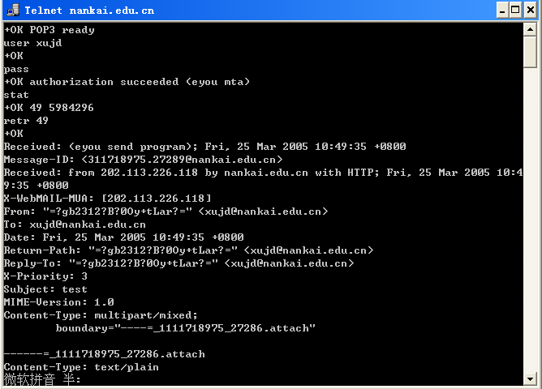
telnet POP3 server
Example:
telnet nankai.edu.cn 110

Slide 115
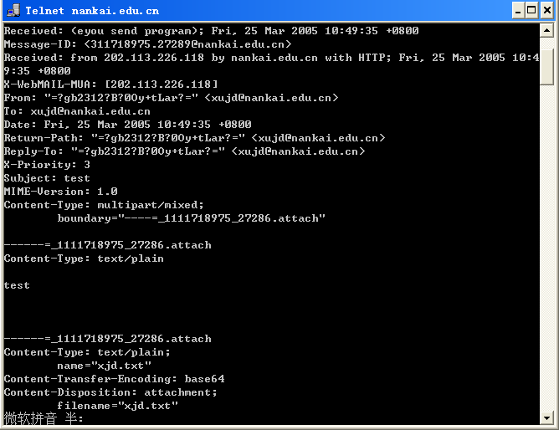
telnet POP3 server

Slide 116
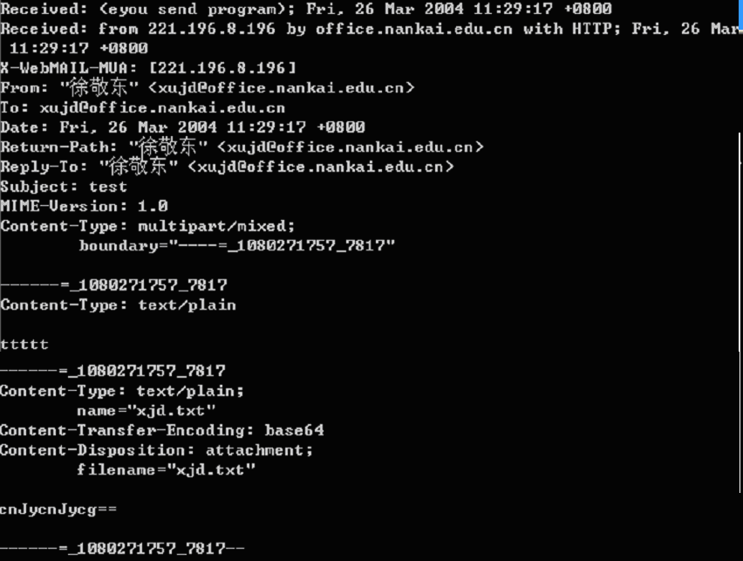
Mail Attachment(RFC 2183)
Notes:
QMail系统安装完成后，其smtp是允许任何人匿名发送邮件的。但是，这一点经常会被恶意的垃圾邮件发送者利用。因此，为了避免这种问题发生，我们为qmail安装并配置smtp发信密码认证功能。 首先我们先来认识一下什么是smtp下的relay规则。 relay规则也可以理解成转发规则。当用户使用telnet到25端口（smtp端口），或者使用类似outlook这样的MUA（用户投递代理）发送邮件时，服务器都会在后端判断是否允许转发（发送）这份邮件，判断的依据是接收方的域名是否在允许之内。 在Qmail中，有一个名为rcpthosts(该文件名源于RCPT TO命令)的配置文件，其决定了是否接受一个邮件。只有当一个RCPT TO命令中的接收者地址的域名存在于rcpthosts文件中时，才接受该邮件,否则就拒绝该邮件。若该文件不存在，则所有的邮件将被接受。当一个邮件服务器不管邮件接收者和邮件接收者是谁，而是对所有邮件进行转发(relay)，则该邮件服务器就被称为开放转发(open relay)的。当qmail服务器没有rcpthosts时，其是开放转发的。 设置自己服务器为非open relay的最简单的办法就是将你的邮件服务器的所有域名(若DNS的MX记录指向该机器，也应该包括该域名。）但是要想实现smtp用户漫游功能，也就是任何网络的合法用户都能发信，仅使用rcphosts就很难操作了，因为不可能每一个用户连接进来就修改一次rcphosts，使之包括发信人域名和ip，再重起qmail。显然，这种方法很不现实。别担心。 qmail-smtpd支持一种有选择性的忽略rcpthosts文件的方法：若qmail-smtpd的环境变量RELAYCLIENT被设置，则rcpthost文件将被忽略，relay将被允许。但是如何识别一个邮件发送者是否是自己的客户呢？qmail并没有采用密码认证的方法，而是判断发送邮件者的源IP地址，若该IP地址属于本地网络，则认为该发送者为自己的客户。 如果要实现SMTP认证后的relay ，不需要对任何IP进行预先设定，所以默认规则设置成“只对本服务器relay”。

Slide 117
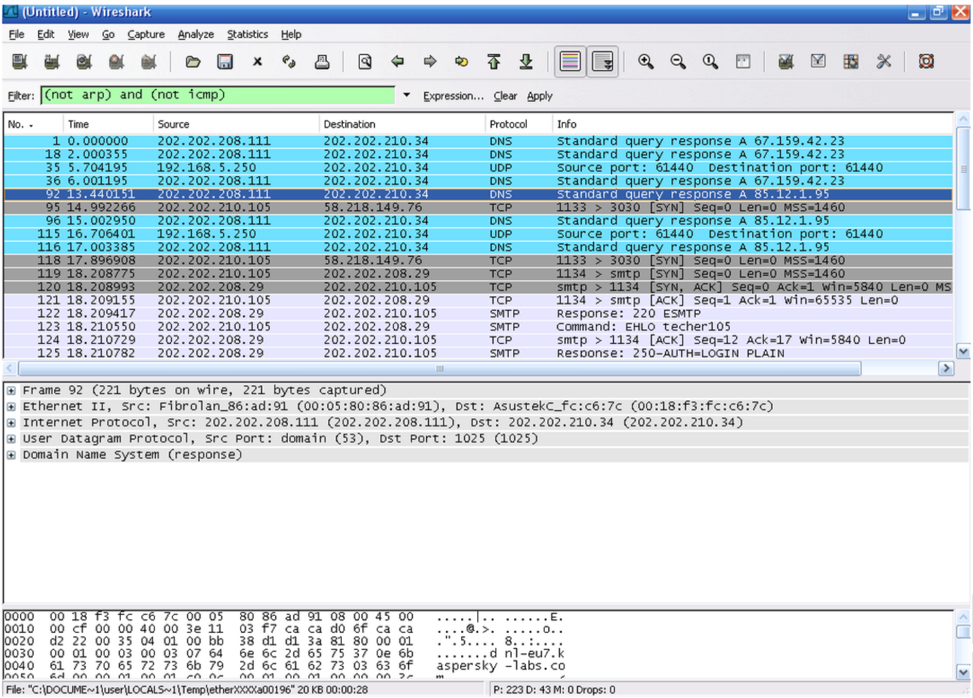

Slide 118
DNS: Domain Name System
2.6 域名服务系统
Internet communication requires IP addresses
Humans prefer to use names
Automated system available to translate names to addresses
Known as Domain Name System (DNS)

Slide 119
Hierarchical Names
2.6 域名服务系统
Accommodate a large, rapidly expanding set of names without requiring a central site
Decentralize the naming mechanism by delegating authority for parts of the namespace
Distribute responsibility for the mapping between names and addresses
Partitioning of a namespace
Support efficient name mapping
Guarantee autonomous control of name assignment

Slide 120
Hierarchical Names (Cont.)
2.6 域名服务系统
Authority for names
Namespace is partitioned at the top level
Authority for names in subdivisions is passed to designated agents
For example
local.site
Subset Authority
Authority may be further subdivided at each level
For example
local.group.site

Slide 121
Internet Domain Name System
2.6 域名服务系统
Hierarchical naming scheme
Abstract:
name syntax
rules for delegating authority
Concrete:
implementation of a distributed computing system that efficiently maps names to addresses
RFC 1034, 1035
RFC 1034: domain names - concepts and facilities
RFC 1035: Domain names - implementation and specification

Slide 122
DNS Name Space
2.6 域名服务系统
geographic scheme
organizational scheme
Domain Name Partition
Organizational scheme
Geographic scheme
Notes:
As of June 2009, there are 20 generic top-level domains (gTLDs) and 248 country code top-level domains (ccTLDs).
In addition, the ARPA domain is used for technical name spaces in the management of Internet addressing and other resources.
A TEST domain is used for testing internationalized domain names

Slide 123
DNS Name Space (Cont.）
2.6 域名服务系统
Top-level Domain Name | Assigned to
com edu gov mil net org arpa int country code | Commercial organizations Educational institutions Government institutions Military groups Major network support centers Organizations other than those above Temporary ARPANET domain International organizations An country

Slide 124
DNS Name Space (Cont.）
2.6 域名服务系统
划分模式 | 我国二级域名 | 分配给
类 别 域 名 | ac | 科研机构
 | com | 工、商、金融等企业
 | edu | 教育机构
 | gov | 政府部门
 | net | 互联网络、接入网络信息中心和运行中心
 | org | 各种非盈利性的组织
行 政 区 域 名 | bj | 北京市
 | sh | 上海市
 | tj | 天津市
 | cq | 重庆市
 | …… | …….

Slide 125
Domain Name Syntax
2.6 域名服务系统
Alphanumeric label (segment) separated by dots, most significant part on right
edu.cn
nankai.edu.cn
it.nankai.edu.cn

Slide 126
Name Resolution
2.6 域名服务系统
Mapping names to addresses
distributed
a set of servers operating at multiple sites cooperatively solve the mapping problem
efficient
most name can be mapped locally, only a few require internet traffic
reliable
no single machine failure will prevent the system from operating correctly
general purpose
not restricted to machine names

Slide 127
Name Resolution (Cont.)
2.6 域名服务系统
Name server
A server program that supplies name-to-address translation, mapping from domain names to IP address
Name resolver
A client software that request name resolving
Use one or more name servers when mapping name to address

Slide 128
Name Server Hierarchy (Cont.)
2.6 域名服务系统
name server: each name server contains the information of one or more zone
parent server knows child server

Slide 129
Name servers
2.6 域名服务系统
root name server
contacted by local name server that can not resolve name
contacts authoritative name server if name mapping not known
gets mapping
returns mapping to local name server

Slide 130
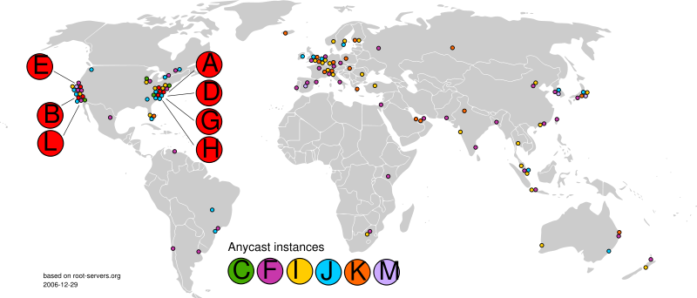
Root name servers
2.6 域名服务系统
13 root name servers worldwide, letter.root-servers.net
Notes:
There are currently 13 root name servers specified, with names in the form letter.root-servers.net, where letter ranges from A to M. This does not mean there are 13 physical servers; each operator uses redundant computer equipment to provide reliable service even if failure of hardware or software occur. Additionally, nine of the servers operate in multiple geographical locations using a routing technique called anycast, providing increased performance and even more fault tolerance.

Slide 131
Name servers
2.6 域名服务系统
top-level domain (TLD) servers:
responsible for com, org, net, edu, etc, and all top-level country domains uk, fr, ca, jp.
authoritative name server:
organization’s DNS servers, providing authoritative hostname to IP mappings for organization’s servers (e.g., Web, mail).
can be maintained by organization or service provider
local name servers:
each ISP (residential ISP, company, university) has one. also called “default name server”
when host makes DNS query, query is sent to its local DNS server

Slide 132
DNS name resolution example
2.6 域名服务系统
root DNS server
2
Host at tsinghua.edu.cn wants IP address for www.nankai.edu.cn
iterated query:
contacted server replies with name of server to contact
“I don’t know this name, but ask this server”
3
TLD DNS server
4
5
local DNS server
tsinghua.edu.cn
7
6
1
8
authoritative DNS server
nankai.edu.cn
requesting host
www.nankai.edu.cn

Slide 133
DNS name resolution example
2.6 域名服务系统
root DNS server
2
3
recursive query:
puts burden of name resolution on contacted name server
heavy load?
7
6
TLD DNS server
local DNS server
tsinghua.edu.cn
5
4
1
8
authoritative DNS server
nankai.edu.cn
requesting host
www.nankai.edu.cn

Slide 134
Name server caching
2.6 域名服务系统
Lower the cost of lookup for nonlocal names
Name to address binding change infrenquently
Server maintain a cache
once name server learns mapping, it caches mapping
record of where the mapping information for that name obtained
set timeout of entries according to authority TTL, cache entries timeout after some time
TLD servers typically cached in local name servers, thus root name servers not often visited

Slide 135
Name server caching (Cont.)
2.6 域名服务系统
Server report cache information to client
mark nonauthoritative binding
give the domain name and IP address of the server obtained binding
Client receive answers quickly, but information may be out-of-date
If efficiency is important, the client will accept the nonauthoritative answer
If accuracy is important, the client will contact the authority and verify the binding is still valid

Slide 136
Host caching
2.6 域名服务系统
Method
download the database of names and addresses from local name server at startup
periodically obtain new mapping
cache recently used names
Advantages
without any network activity, name resolution extremely fast
failure of local server don’t influence name resolution
reduce the computational load on the name server

Slide 137
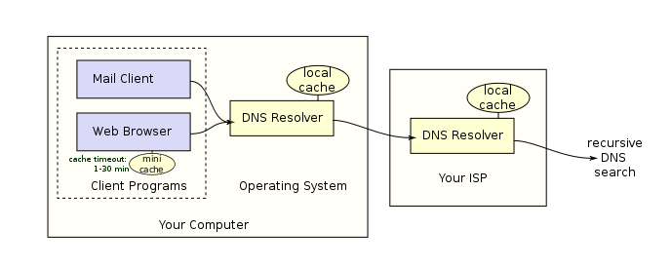
Caching
2.6 域名服务系统
Notes:
1、SNMPv2在安全方面做了大量的工作，但由于缺少一致性支持，在最终的规范中仍然采用基于团体的安全管理框架（即SNMPv2C）（RFC 1901)(Community-based SNMPv2 (SNMPv2C))
2、RFC1901-RFC1908定义了SNMPv2C
3、主要增强
1）get-bulk message: 表检索
2）manager之间的互操作
3）SMIv2定义根加规范化(RFC1902-RFC1904)，包括module definitions, object definitions and trap definitions
MODULE-IDENTITY
OBJECT-IDENTITY
OBJECT-TYPE
NOTIFICATION-TYPE
4) 定义新的数据类型
5) 定义了最小的能力集
6) RowStatus
7) system group, SNMP group, security group, snmpv2 group
8) 其他协议对SNMP的支持

Slide 138
Resource Record Structure
2.6 域名服务系统
DNS: distributed database storing Resource Records (RR)
Record structure
Name
Time to live: usually set to 86400s for authority resource record
Type
Class: Internet, I.e., IN
Value
Alone database for each zone

Slide 139
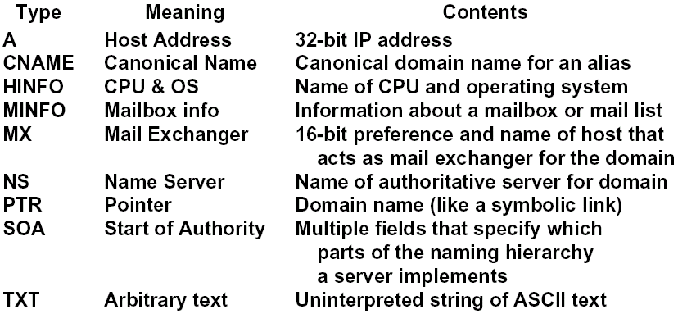
Resource Record Type
2.6 域名服务系统
Type of IPv6 address: AAAA
Notes:
preference：优先级

Slide 140
Example of DNS Database
2.6 域名服务系统
cs.vu.nl. 86400 IN SOA star boss (serial,refresh,retry,expire,ttl)
cs.vu.nl. 86400 IN TXT “A University”
cs.vu.nl. 86400 IN MX 1 zephyer.cs.vu.nl.
cs.vu.nl. 86400 IN MX 2 top.cs.vu.nl.
flits.cs.vu.nl. 86400 IN HINFO Sun Unix
flits.cs.vu.nl. 86400 IN A 130.37.16.112
flits.cs.vu.nl. 86400 IN MX 1 flits.cs.vu.nl.
flits.cs.vu.nl. 86400 IN MX 2 zephyer.cs.vu.nl.
flits.cs.vu.nl. 86400 IN MX 3 top.cs.vu.nl.
www.cs.vu.nl. 86400 IN CNAME top.cs.vu.nl.
ftp.cs.vu.nl. 86400 IN CNAME zephyer.cs.vu.nl.
zephyer 86400 IN A 130.37.56.201
IN HINFO Sun Unix

Slide 141
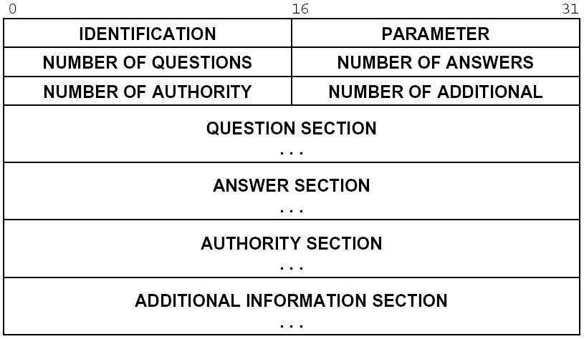
DNS Message Format
2.6 域名服务系统
DNS protocol : query and reply messages, both with same message format
Notes:
Question Carries the query name and other query parameters.
Answer Carries RRs which directly answer the query.
Authority Carries RRs which describe other authoritative servers. May optionally carry the SOA RR for the authoritative data in the answer section.
Additional Carries RRs which may be helpful in using the RRs in the other sections.
For example, a mailer tying to send mail to Mockapetris@ISI.EDU might ask the resolver for mail information about ISI.EDU, resulting in a query for QNAME=ISI.EDU, QTYPE=MX, QCLASS=IN. The response's answer section would be:
ISI.EDU. MX 10 VENERA.ISI.EDU.
MX 10 VAXA.ISI.EDU.
while the additional section might be:
VAXA.ISI.EDU. A 10.2.0.27
A 128.9.0.33
VENERA.ISI.EDU. A 10.1.0.52
A 128.9.0.32

Slide 142
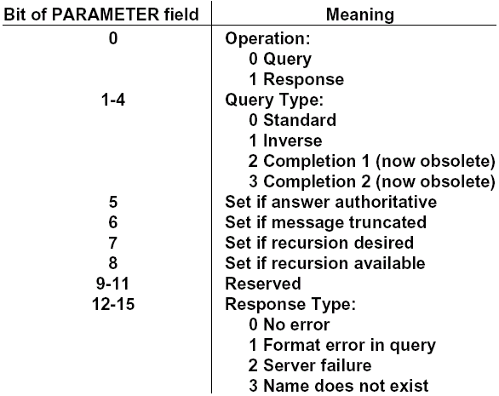
Message Format (Cont.)
2.6 域名服务系统

Slide 143
Message Format (Cont.)
2.6 域名服务系统
Question: Carries the query name and other query parameters.
Answer: Carries RRs which directly answer the query.
Authority: Carries RRs which describe other authoritative servers. May optionally carry the SOA RR for the authoritative data in the answer section.
Additional: Carries RRs which may be helpful in using the RRs in the other sections.

Slide 144
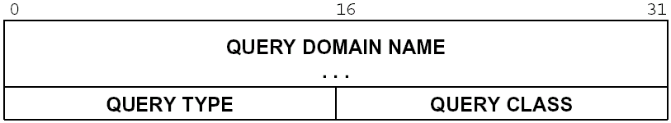
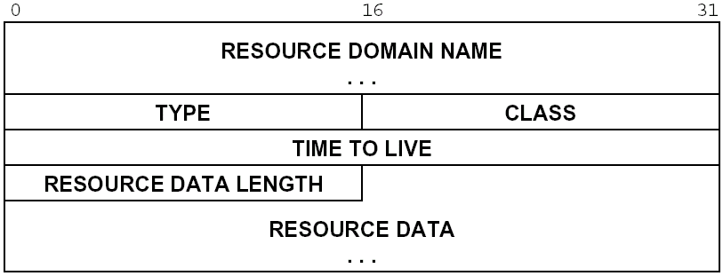
Message Format (Cont.)
2.6 域名服务系统
question
answer
authority
additional
Notes:
The QTYPE field may contain:
<any type> matches just that type. (e.g., A, PTR).
AXFR special zone transfer QTYPE.
MAILB matches all mail box related RRs (e.g. MB and MG).
matches all RR types.
The QCLASS field may contain:
<any class> matches just that class (e.g., IN, CH).
* matches aLL RR classes.

Slide 145
Compressed Name Format
2.6 域名服务系统
Domain name representation in message
each segment: first octet specifies length (n), following n octets (00xxxxxx)
Length octet containing zero marks the end of name
Compress format
Suffixes of domain usually overlap in multiple
Name server store only one copy of each domain name
Pointer
top two bits of segment count field is 1s, next 14 bits is pointer (11xxxxxxxxxxxxxx)
Notes:
4.1.4. Message compression
In order to reduce the size of messages, the domain system utilizes a
compression scheme which eliminates the repetition of domain names in a
message. In this scheme, an entire domain name or a list of labels at
the end of a domain name is replaced with a pointer to a prior occurance
of the same name.
The pointer takes the form of a two octet sequence:
+--+--+--+--+--+--+--+--+--+--+--+--+--+--+--+--+
| 1 1| OFFSET |
+--+--+--+--+--+--+--+--+--+--+--+--+--+--+--+--+
The first two bits are ones. This allows a pointer to be distinguished
from a label, since the label must begin with two zero bits because
labels are restricted to 63 octets or less. (The 10 and 01 combinations
are reserved for future use.) The OFFSET field specifies an offset from
the start of the message (i.e., the first octet of the ID field in the
domain header). A zero offset specifies the first byte of the ID field,
etc.
The compression scheme allows a domain name in a message to be
represented as either:
- a sequence of labels ending in a zero octet
- a pointer
- a sequence of labels ending with a pointer
Pointers can only be used for occurances of a domain name where the
format is not class specific. If this were not the case, a name server
or resolver would be required to know the format of all RRs it handled.
As yet, there are no such cases, but they may occur in future RDATA
formats.
If a domain name is contained in a part of the message subject to a
length field (such as the RDATA section of an RR), and compression is
used, the length of the compressed name is used in the length
calculation, rather than the length of the expanded name.
Programs are free to avoid using pointers in messages they generate,
although this will reduce datagram capacity, and may cause truncation.
However all programs are required to understand arriving messages that
contain pointers.
For example, a datagram might need to use the domain names F.ISI.ARPA,
FOO.F.ISI.ARPA, ARPA, and the root. Ignoring the other fields of the
message, these domain names might be represented as:
+--+--+--+--+--+--+--+--+--+--+--+--+--+--+--+--+
20 | 1 | F |
+--+--+--+--+--+--+--+--+--+--+--+--+--+--+--+--+
22 | 3 | I |
+--+--+--+--+--+--+--+--+--+--+--+--+--+--+--+--+
24 | S | I |
+--+--+--+--+--+--+--+--+--+--+--+--+--+--+--+--+
26 | 4 | A |
+--+--+--+--+--+--+--+--+--+--+--+--+--+--+--+--+
28 | R | P |
+--+--+--+--+--+--+--+--+--+--+--+--+--+--+--+--+
30 | A | 0 |
+--+--+--+--+--+--+--+--+--+--+--+--+--+--+--+--+
+--+--+--+--+--+--+--+--+--+--+--+--+--+--+--+--+
40 | 3 | F |
+--+--+--+--+--+--+--+--+--+--+--+--+--+--+--+--+
42 | O | O |
+--+--+--+--+--+--+--+--+--+--+--+--+--+--+--+--+
44 | 1 1| 20 |
+--+--+--+--+--+--+--+--+--+--+--+--+--+--+--+--+
+--+--+--+--+--+--+--+--+--+--+--+--+--+--+--+--+
64 | 1 1| 26 |
+--+--+--+--+--+--+--+--+--+--+--+--+--+--+--+--+
+--+--+--+--+--+--+--+--+--+--+--+--+--+--+--+--+
92 | 0 | |
+--+--+--+--+--+--+--+--+--+--+--+--+--+--+--+--+
The domain name for F.ISI.ARPA is shown at offset 20. The domain name
FOO.F.ISI.ARPA is shown at offset 40; this definition uses a pointer to
concatenate a label for FOO to the previously defined F.ISI.ARPA. The
domain name ARPA is defined at offset 64 using a pointer to the ARPA
component of the name F.ISI.ARPA at 20; note that this pointer relies on
ARPA being the last label in the string at 20. The root domain name is
defined by a single octet of zeros at 92; the root domain name has no
labels.

Slide 146
Compressed Name Format: example
2.6 域名服务系统
A datagram might need to use the domain names F.ISI.ARPA, FOO.F.ISI.ARPA, ARPA, and the root. Ignoring the other fields of the message, these domain names might be represented as:
20
1
F
40
3
F
22
3
I
42
O
O
24
S
I
44
11
20
26
4
A
64
11
26
28
R
P
30
A
0
92
0
Notes:
4.1.4. Message compression
In order to reduce the size of messages, the domain system utilizes a
compression scheme which eliminates the repetition of domain names in a
message. In this scheme, an entire domain name or a list of labels at
the end of a domain name is replaced with a pointer to a prior occurance
of the same name.
The pointer takes the form of a two octet sequence:
+--+--+--+--+--+--+--+--+--+--+--+--+--+--+--+--+
| 1 1| OFFSET |
+--+--+--+--+--+--+--+--+--+--+--+--+--+--+--+--+
The first two bits are ones. This allows a pointer to be distinguished
from a label, since the label must begin with two zero bits because
labels are restricted to 63 octets or less. (The 10 and 01 combinations
are reserved for future use.) The OFFSET field specifies an offset from
the start of the message (i.e., the first octet of the ID field in the
domain header). A zero offset specifies the first byte of the ID field,
etc.
The compression scheme allows a domain name in a message to be
represented as either:
- a sequence of labels ending in a zero octet
- a pointer
- a sequence of labels ending with a pointer
Pointers can only be used for occurances of a domain name where the
format is not class specific. If this were not the case, a name server
or resolver would be required to know the format of all RRs it handled.
As yet, there are no such cases, but they may occur in future RDATA
formats.
If a domain name is contained in a part of the message subject to a
length field (such as the RDATA section of an RR), and compression is
used, the length of the compressed name is used in the length
calculation, rather than the length of the expanded name.
Programs are free to avoid using pointers in messages they generate,
although this will reduce datagram capacity, and may cause truncation.
However all programs are required to understand arriving messages that
contain pointers.
For example, a datagram might need to use the domain names F.ISI.ARPA,
FOO.F.ISI.ARPA, ARPA, and the root. Ignoring the other fields of the
message, these domain names might be represented as:
+--+--+--+--+--+--+--+--+--+--+--+--+--+--+--+--+
20 | 1 | F |
+--+--+--+--+--+--+--+--+--+--+--+--+--+--+--+--+
22 | 3 | I |
+--+--+--+--+--+--+--+--+--+--+--+--+--+--+--+--+
24 | S | I |
+--+--+--+--+--+--+--+--+--+--+--+--+--+--+--+--+
26 | 4 | A |
+--+--+--+--+--+--+--+--+--+--+--+--+--+--+--+--+
28 | R | P |
+--+--+--+--+--+--+--+--+--+--+--+--+--+--+--+--+
30 | A | 0 |
+--+--+--+--+--+--+--+--+--+--+--+--+--+--+--+--+
+--+--+--+--+--+--+--+--+--+--+--+--+--+--+--+--+
40 | 3 | F |
+--+--+--+--+--+--+--+--+--+--+--+--+--+--+--+--+
42 | O | O |
+--+--+--+--+--+--+--+--+--+--+--+--+--+--+--+--+
44 | 1 1| 20 |
+--+--+--+--+--+--+--+--+--+--+--+--+--+--+--+--+
+--+--+--+--+--+--+--+--+--+--+--+--+--+--+--+--+
64 | 1 1| 26 |
+--+--+--+--+--+--+--+--+--+--+--+--+--+--+--+--+
+--+--+--+--+--+--+--+--+--+--+--+--+--+--+--+--+
92 | 0 | |
+--+--+--+--+--+--+--+--+--+--+--+--+--+--+--+--+
The domain name for F.ISI.ARPA is shown at offset 20. The domain name
FOO.F.ISI.ARPA is shown at offset 40; this definition uses a pointer to
concatenate a label for FOO to the previously defined F.ISI.ARPA. The
domain name ARPA is defined at offset 64 using a pointer to the ARPA
component of the name F.ISI.ARPA at 20; note that this pointer relies on
ARPA being the last label in the string at 20. The root domain name is
defined by a single octet of zeros at 92; the root domain name has no
labels.

Slide 147
Message Format: example
2.6 域名服务系统
A mailer tying to send mail to Mockapetris@ISI.EDU might ask the resolver for mail information about ISI.EDU
Query: question section
QNAME=ISI.EDU, QTYPE=MX, QCLASS=IN
Reply: answer section
ISI.EDU. MX 10 VENERA.ISI.EDU.
MX 10 VAXA.ISI.EDU.
Reply: additional section
VAXA.ISI.EDU. A 10.2.0.27
A 128.9.0.33
VENERA.ISI.EDU. A 10.1.0.52
A 128.9.0.32

Slide 148
Message Format: example
2.6 域名服务系统
If a query (QNAME=BRL.MIL, QTYPE=A) is sent to C.ISI.EDU, the reply would be:
answer section
<empty>
authority section
MIL. 86400 IN NS SRI-NIC.ARPA.
86400 NS A.ISI.EDU.
additional section
A.ISI.EDU. A 26.3.0.103
SRI-NIC.ARPA. A 26.0.0.73
A 10.0.0.51

Slide 149
P2P architecture
2.7 对等通信
Three topics:
File distribution
Searching for information
Case Study: Skype
peer-peer

Slide 150
File Distribution: Client-Server vs P2P
2.7 对等通信
Question : How much time to distribute file from one server to N peers?
u_{s}: server upload bandwidth
Server
u_{i}: peer i upload bandwidth
u₁
d₁
u₂
d₂
u_{s}
d_{i}: peer i download bandwidth
File, size F
d_{N}
Network (with
abundant bandwidth)
u_{N}

Slide 151
File distribution time: client-server
2.7 对等通信
Server
server sequentially sends N copies:
NF/u_{s} time
client i takes F/d_{i} time to download
F
u₁
d₁
u₂
u_{s}
d₂
d_{N}
Network (with
abundant bandwidth)
u_{N}
Time to distribute F
to N clients using
client/server approach
= d_{cs} = max { NF/u_{s}, F/min(d_{i}) }
i
increases linearly in N(for large N)

Slide 152
File distribution time: P2P
2.7 对等通信
Server
server must send one copy: F/u_{s} time
client i takes F/d_{i} time to download
NF bits must be downloaded (aggregate)
F
u₁
d₁
u₂
u_{s}
d₂
d_{N}
Network (with
abundant bandwidth)
u_{N}
fastest possible upload rate: u_{s} + Σu_{i}
d_{P2P} = max { F/u_{s}, F/min(d_{i}) , NF/(u_{s} + Σu_{i}) }
i

Slide 153
2.7 对等通信
Server-client vs. P2P: example
Client upload rate = u, F/u = 1 hour, u_{s} = 10u, d_{min} ≥ u_{s}

Slide 154
File distribution: BitTorrent
2.7 对等通信
tracker: tracks peers
participating in torrent
torrent: group of
peers exchanging
chunks of a file
obtain list
of peers
trading
chunks
peer

Slide 155
BitTorrent (1)
2.7 对等通信
file divided into 256KB chunks.
peer joining torrent:
has no chunks, but will accumulate them over time
registers with tracker to get list of peers, connects to subset of peers (“neighbors”)
while downloading, peer uploads chunks to other peers.
peers may come and go
once peer has entire file, it may (selfishly) leave or (altruistically) remain

Slide 156
BitTorrent (2)
2.7 对等通信
Sending Chunks: tit-for-tat
Alice sends chunks to four neighbors currently sending her chunks at the highest rate periodically, a peer (Alice) asks each neighbor for list of chunks that they have.
reevaluate top 4 every 10 secs
30 secs: randomly select another peer, starts sending chunks
newly chosen peer may join top 4
“optimistically unchoke”
Pulling Chunks
at any given time, different peers have different subsets of file chunks
periodically, a peer (Alice) asks each neighbor for list of chunks that they have.
Alice sends requests for her missing chunks
rarest first

Slide 157
BitTorrent: Tit-for-tat
2.7 对等通信
(1) Alice “optimistically unchokes” Bob
(2) Alice becomes one of Bob’s top-four providers; Bob reciprocates
(3) Bob becomes one of Alice’s top-four providers
With higher upload rate, can find better trading
partners & get file faster!

Slide 158
P2P: searching for information
2.7 对等通信
Index in P2P system: maps information to peer location
(location = IP address & port number)
File sharing (eg. e-mule)
Index dynamically tracks the locations of files that peers share.
Peers need to tell index what they have.
Peers search index to determine where files can be found
Instant messaging
Index maps user names to locations.
When user starts IM application, it needs to inform index of its location
Peers search index to determine IP address of user.

Slide 159
P2P: centralized index
2.7 对等通信
Original “Napster” design
1) when peer connects, it informs central server:
IP address
content
2) Alice queries for “Hey Jude”
3) Alice requests file from Bob
Bob
centralized
directory server
1
peers
1
1
3
2
1
file transfer is decentralized, but locating content is highly centralized
single point of failure
performance bottleneck
Alice

Slide 160
Query flooding
2.7 对等通信
fully distributed
no central server
used by Gnutella
Each peer indexes the files, it makes available for sharing
overlay network: graph
edge between peer X and Y if there’s a TCP connection
all active peers and edges form overlay net
edge: virtual (not physical) link
given peer typically connected with < 10 overlay neighbors

Slide 161
Query flooding
2.7 对等通信
File transfer:HTTP
Query message sent over existing TCP connections
peers forward Query message
QueryHit sent over reverse path
Query
QueryHit
Query
Query
QueryHit
Query
QueryHit
Scalability: limited scope flooding
Query

Slide 162
Hierarchical Overlay
2.7 对等通信
between centralized index, query flooding approaches
each peer is either a super node or assigned to a super node
TCP connection between peer and its super node.
TCP connections between some pairs of super nodes.
Super node tracks content in its children

Slide 163

P2P Case study: Skype
2.7 对等通信
Skype clients (SC)
inherently P2P: pairs of users communicate.
proprietary application-layer protocol (inferred via reverse engineering)
hierarchical overlay with SNs
Index maps usernames to IP addresses; distributed over SNs
Supernode(SN)

Slide 164
Summary
application service requirements:
reliability, bandwidth, delay
Internet transport service model
connection-oriented, reliable: TCP
unreliable, datagrams: UDP
client-server and p2p
specific protocols:
ftp
http
smtp, pop3
dns
p2p

